Slide 1
AHFA Multifamily Essentials
An Introduction to the Low-Income Housing Tax Credit, HOME, National Housing Trust Fund (HTF) and Multifamily Bond Programs in Alabama

Slide 2
Ahfa allocation amounts
Funding | Housing Credit | HOME | National Housing Trust Fund (HTF)
Allocation (estimated) | $15.0M* | $10.8 M | $3.0 M
Set Asides | Non-profit 10% | CHDO 15% | None
Caps | 15% | 25% | $1.35M
Uses | New Construction Acquisition /Rehab Adaptive Reuse | New Construction | New Construction
Units | Min: 12 Max: Cap Based | Min: 12 Max: 56 | Min: 1 Max: $1.35M Cap
Each state’s 9% Housing Credit allocation is subject to a volume cap based on its population limiting the availability of the Credit in each state. Volume cap figures are published by the IRS on an annual basis.
The Annual HOME Allocation is established by Congress in each annual budget appropriation.
The Annual HTF Allocation is based on funds contributed by Fannie Mae and Freddie Mac and an equation is used to determine the allocation for each state.
Please Note: The figures in the table are provided only as examples and are subject to change each year.
*M=Million

Slide 3

Low-Income Housing Tax Credit Program (Housing Credit)
The Low-Income Housing Tax Credit (LIHTC) program
is the largest production driver of new and rehabilitated affordable rental housing in the nation. Each year, the Internal Revenue Service distributes housing credits to state housing finance agencies.

Slide 4

AHFA, as Alabama’s designated administrator of the LIHTC program, then allocates these credits by conducting a competitive application cycle that ensures credits are distributed throughout the state to areas with the greatest needs. AHFA implements allocation plans each year, which include selection criteria, an evaluation process, design quality standards, environmental requirements, and compliance monitoring procedures.

Slide 5
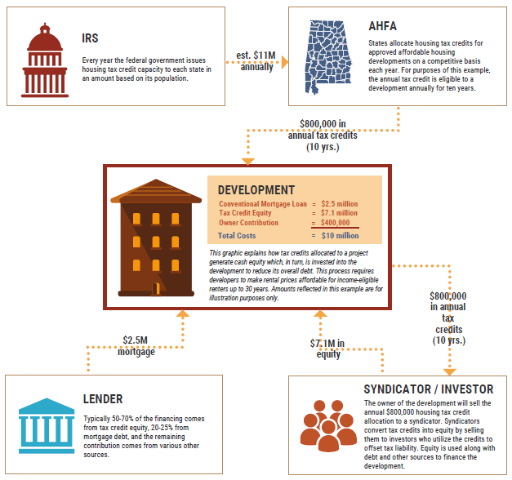
The housing credit offers a dollar-for-dollar reduction in a taxpayer’s income tax liability in return for making a long-term investment in affordable rental housing. State agencies award Housing Credits to developers, who then sell the credits to private investors in exchange for funding for the construction and rehabilitation of affordable housing. These funds allow developers to borrow less money and pass through the savings in lower rents for low‐income tenants. Investors, in turn, receive a 10‐year tax credit based on the cost of constructing or rehabilitating apartments that cannot be rented to anyone whose income exceeds 60% of area median income (AMI).
Please Note: The figures in infographics are for demonstration purposes only and do not reflect actual project funding.

Slide 6
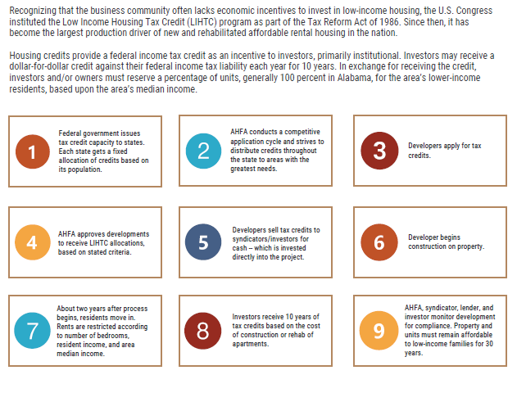
Housing credits provide a federal income tax credit as an incentive to investors. Investors may receive a dollar-for-dollar credit against their federal income tax liability each year for 10 years. In exchange for receiving the credit, investors and/or owners must reserve a percentage of units for the area’s lower-income residents, based upon the area’s median income. In turn, owners generally make a 30-year commitment to ensure the units are decent, safe, and affordable for eligible tenants.
Please Note: The figures in infographics are for demonstration purposes only and do not reflect actual project funding

Slide 7
Housing Credit overview

Slide 8
Low Income housing tax credit program (Housing credit overview)
Governing Document: Section 42 of the Internal Revenue Code in 1986
The Housing Credit Program is the country’s most extensive affordable rental housing program.
As of 2023, the Low-Income Housing Tax Credit (LIHTC) program has helped create or preserve approximately 3.7 million affordable rental housing units. (HUD LIHTC Property Level Data Portal)
Provides a place to call home for low- and moderate- income households.
Novogradac, Michael J., CPA. "Exporting the Low-Income Housing Tax Credit." Novogradac, Journal of Tax Credits, June 2015, 4-6.

Slide 9
Housing credit overview
Subsidy Program offering an incentive to build affordable housing which can compete in the general marketplace.
Generates approximately 96,000 jobs per year.
Approximately $100 billion in private investment has been leveraged by the program.
Generates $3.5 billion in federal, state and local taxes.
Generates $9.1 billion in economic income.
Novogradac, Michael J., CPA. “Exporting the Low-Income Housing Tax Credit.” Novogradac, Journal of Tax Credits, June 2015,4-6

Slide 10
Housing Credit Overview
Internal Revenue Service (IRS) allocates funds to states on a per capita basis.
  Rates are adjusted annually for inflation.
Investors purchase housing credits in qualified properties that have received state award.
  Creates cash equity for owners that reduces project development debt burden.
  The owner agrees to rent a specific number of units to qualified tenants at specified rents.
  Two levels of tax credits are available:
    9% Credits for New Construction or Rehabilitation
    4% Credits for Acquisition or Multifamily Bond Financing

Slide 11
Housing credit overview
IRS
Generate Housing Credits
AHFA
Award Housing Credits
Applicant / Owner
Apply for Housing Credits

Slide 12
Housing Credit Overview
Ownership requirements
Initial 15-year compliance period
Housing Credits are subject to recapture penalties
Owner (a corporation, nonprofit, or individual) partners with investors (generally a corporation or individual)
Housing Credits are sold to the investors in exchange for cash equity
  Investors, usually the Limited Partnership (LP), benefit from the Housing Credits
  The Development benefits from the cash infusion received from the sale of Housing Credits
Investors generally transfer the LP interest to the GP at the end of the initial 15-year compliance period

Slide 13
Housing Credit Overview restrictive covenants
Term of Restrictions
  Properties developed 1986-1989 had a 15-year compliance period.
  Properties developed since 1990 have at least a 30-year affordability period.
    15-year compliance period
    15-year extended use period
    Additional Extended Use
Restrictions are recorded against the property

Slide 14
Housing credit overview
Income and rent restrictions
An owner must choose one of three occupancy restrictions:
  At least 20% of residential rental units shall be rent & income restricted at 50% of AMI*.
  At least 40% of residential rental units shall be rent & income restricted at 60% of AMI.
  Most applicants select 100% of the rental residential units to be rent restricted at the 60% rent level or less as defined by the rent limits published by HUD and occupied by individuals whose income is 60% or less of the AMI.
*AMI: Area Median Income

Slide 15
HOME investment Partnerships Program (HOME)
Overview

Slide 16
HOME Overview
Federal
Governing Agency
  US Department of Housing and Urban Development (HUD)
Law:
  TITLE II of the Cranston-Gonzalez National Affordable Housing Act
Regulations:
  TITLE 24 CFR, Subtitle A., Part 92 – HOME Investment Partnerships Program, Final Rule
  TITLE 24 CFR, Parts 5, 91, 92, et al. Affirmatively Furthering Fair Housing; Final Rule
Policy
  CPD Notices
States are Permitted to Determine How the Program is Administered.

Slide 17
HOME Overview
Federal
HOME Program started in 1992
HOME has produced over one million units
Congress cut funding 38% in 2012 and imposed tighter restrictions on the Program in FY12 and FY13
HOME Final Rule was published and became effective in 2013
The Affirmatively Furthering Fair Housing Final Rule was published and became effective in 2015
Further cuts to the Program are expected

Slide 18
HOME Overview
Participating Jurisdictions (PJs)
State PJ
  Alabama Housing Finance Authority
  States receive 40% of the total HOME funding
City/County PJs
  Localities receive 60% of the total HOME funding based on a formula established by HUD.
  Various Housing Programs
    Homebuyer
    Homeowner
    Rental Assistance

Slide 19
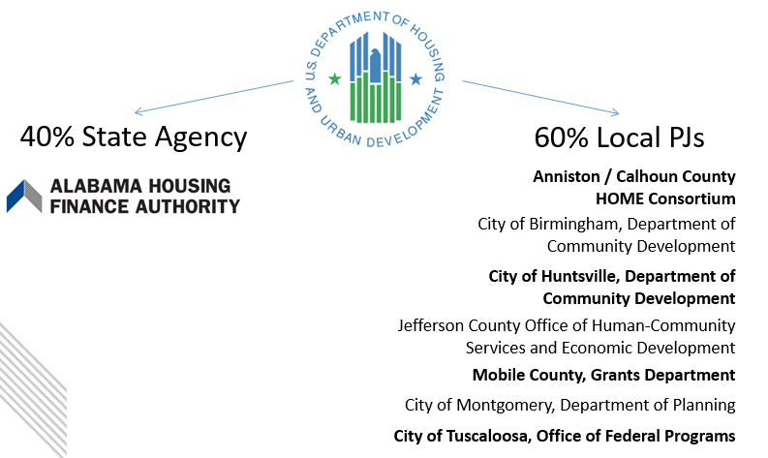

HOME Overview
Alabama Funding Distribution
*AHFA will not accept or consider an application for HOME funds submitted in a city or county that is a HUD approved PJ and receives its own allocation of HOME Funds.

Slide 20
HOME Overview
The CHDO Set-Aside
Community Housing Development Organization
  Specific type of designation for non-profits
15% of the Annual Allocation is reserved for CHDO projects:
  Rental Housing
  Reservation = project commitment
  92.300 definitions: owned/developed

Slide 21
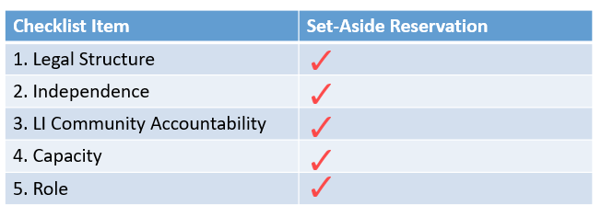
HOME Overview
CHDO Certification
Nonprofit must qualify as CHDO
  At time of reservation (commitment)
  Must meet CHDO definition (92.2) capacity (staff)

Slide 22
HOME Overview
Federal
HOME provides capital funds, not operating.
There are deadlines for project completion and unit occupancy.
There is a 20-year affordability period.
If requirements are not met, the HOME funds must be repaid.
HOME is a Repayable and Foreclosable Loan – Not a Grant Program

Slide 23
HOME Overview
Eligible/Ineligible Uses
Eligible Uses
Ineligible Uses
Acquisition/Site Improvements
New Construction
Project Soft Costs
Non-housing
Non-low-income housing
Shelters
Off-Site Infrastructure
Project Reserves
Public Housing

Slide 24
HOME Overview
Federal: Project Timeline
Project Deadlines
  Completion: four years* from commitment to completion
    Construction Completion and all funds drawn
Occupancy: 18 months to rent all units
*2 years allowed for completion when combined with the Housing Credit Program

Slide 25
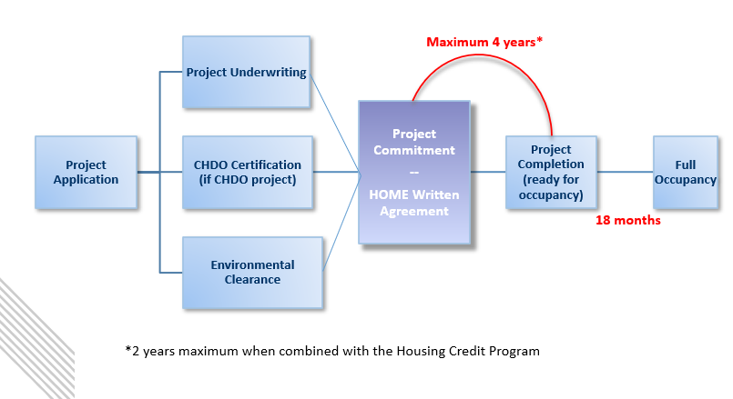
HOME Overview
Federal: Project Timeline

Slide 26
HOME Overview
Cross-Cutting /Other Federal Requirements
HOME recipients are responsible for all applicable Federal Requirements
  Environmental Review
  Relocation: Uniform Relocation Assistance (URA) & The Housing and Development Act (HCDA) of 1974 S. 104(d)
  Labor: Davis Bacon (if 12+ units)
  Equal Employment Opportunity (EEO), Minority and Women- owned Business Enterprise (M/WBE) , Section 3
  Fair Housing & Accessibility: Section 504 & Fair Housing Amendments Act (FHAA)

Slide 27
HOME Overview
HOME Assisted Units
Any unit that receives HOME funds is considered HOME assisted.
HOME units are subject to all HOME requirements, (income restrictions, property standards, affordability period, etc.)

Slide 28
HOME Overview
Program Compliance - The 5 P’s of Compliance
Statutory cornerstones for HOME Assisted Units
  People – income
  Price – rent limits
  Property – property standards
  Period – 20-year affordability period
  Policies: process, procedures, paper
  Franke, Monte. "HOME Essentials." Lecture, The HFA Institute, J.W. Marriott, Washington D.C., January 10, 2016.

Slide 29
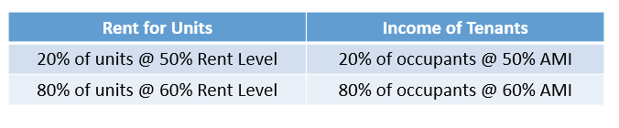
HOME Overview
People : Income and Rent Restrictions
An owner must meet the following occupancy restrictions:
  At least twenty percent (20%) of the units are rent restricted at or below the fifty percent (50%) rent level with the remaining eighty percent (80%) of the units restricted at or below the sixty percent (60%) rent level or fair market value whichever is less as defined by the rent limits published by HUD.
  At least twenty percent (20%) of the units in this project shall be rent restricted and occupied by individuals whose income is fifty percent (50%) or less of the area median income with the remaining eighty percent (80%) of the units to be rent restricted and occupied by individuals whose income is sixty percent (60%) or less of the area median income.
  *More restrictive requirements apply if combined with other sources of funds.

Slide 30
HOME Overview
Price : Affordability
Rent Limits
  HUD publishes annually
  All rents adjusted for tenant-paid utility allowances
  AHFA must approve rents annually
  Limits on fees beyond rent (92.214)

Slide 31
HOME Overview
Property : Property Standards
All HOME-assisted units (HAUs) must meet property standards to ensure decent & sustainable housing
All HAUs must meet applicable state/local codes (or model codes in absence)
Applicable for the full affordability period
Owners certify annually
Additional HUD standards
Federal requirements (e.g., Lead Based Paint (LBP), accessibility)

Slide 32
HOME Overview
Period – Affordability Period
Deed restriction (Land Use Restrictive Covenant)
20-year Affordability period for New Construction Rental
During Affordability Period (reviewed annually):
92.252(f)(2): owners must provide info to PJ.
Certify property standards
92.504(d): on-site sample of files & property inspections.
Within 12 months of completion & every 3* years.
92.504(d)(2): annual financial oversight
*AHFA conducts annual onsite inspections.

Slide 33
HOME Overview
Policies: process, procedures, paper
Written Agreements→ Unit Mix, occupancy requirements, initial rents, deadlines, affordability start
Affirmative Marketing Plan→ Special outreach to those least likely to apply
Tenant Selection Plan→ Preferences, selection policies, and procedures for intake, processing, grievances, waitlist
Lease→ Hud Lease Addendum* must be included in tenant leases
Tenant Participation Plan (CHDOs only)→ Fair lease & grievance procedures, tenant participation in management decisions
*Provided as Addendum to AHFA HOME Written Agreement

Slide 34
National Housing Trust Fund (Htf) requirements

Slide 35

Ahfa’s national housing trust fund program (htf)
The National Housing Trust Fund (HTF) was established by Congress under Title I of the Housing and Economic Recovery Act of 2008. HTF is a formula grant program to be administered by the states. For 2024, HUD allocated to the State of Alabama a grant of $3.4 million. AHFA’s proposal, designed pursuant to HUD guidance, targets Extremely Low-Income populations (ELI), with a preference to homeless and at-risk of becoming homeless veterans of the U.S. armed forces. Data as of 2017 reflects that of the 369,962 veterans living in the state an estimated 29,047 veterans in Alabama fall into the ELI category. In 2018, there were approximately 339 homeless veterans statewide, and with the housing cost burden, this number could increase.
AHFA proposes a National HTF Allocation Plan (the Plan) using a competitive application cycle and point scoring system similar to, but more concise than, the Low-Income Housing Tax Credit program. The Plan is designed to provide funds to develop new construction of decent, safe and sanitary rental housing, with an initial preference for ELI homeless or transitioning veterans located primarily in underserved rural areas.

Slide 36
Htf requirements overview
Federal Program
Goal is to increase decent, safe, and sanitary affordable housing for extremely low-income (ELI) and very low-income (VLI) households.
May be used for a production of new construction rental housing.
Must adhere to a minimum 30-year affordability period.
Reduce the number of homeless individuals and families.
Alabama’s program further encourages provision of veteran housing.

Slide 37
Htf requirements overview
Focus of the AHFA HTF Plans target ELI veteran populations, homeless populations, and populations with mental or physical disabilities.
AHFA offers a rolling application process open to stand-alone applicants or combining with other AHFA programs.
HTF Application requirements and materials are available on the AHFA website.

Slide 38
Htf requirements eligible activities
New Construction of Rental Housing which may include:
-Single Family Homes
-Duplexes
-Multifamily Residential
Must meet AHFA’s Design Quality Standards and Construction Manual for construction of attached new construction rental units or single-family rental homes.

Slide 39
Htf requirements eligible recipients
Recipients must:
  Assure compliance with HTF requirements from application throughout a minimum 30-year compliance period.
  Demonstrate ability and financial capacity to undertake, comply and manage the activity.
  Demonstrate familiarity with other programs which may be used in concert with HTF.
  Demonstrate experience and capacity to conduct HTF activity through multifamily rental housing history.
  Must be in good standing with AHFA and other state housing finance authorities, ADECA, HUD, and USDA Rural Development.
  Must be determined credit worthy, financially sound and lawful.

Slide 40
Htf requirements housing priorities
Category | Points | Criterion
Geographic Diversity | 10 | Non-metropolitan areas
Applicant Capacity- ELI veterans | 25 | Show evidence of having served ELI veterans and describe their strategy for addressing housing problems for ELI veterans.
Applicant Capacity- ELI populations with physical or mental disabilities | 15 | Show evidence of having served ELI populations with physical or mental disabilities and describe their strategy for addressing housing problems for populations with physical or mental disabilities.
Applicant Capacity- Other ELI under served populations, such as, persons who are experiencing homelessness or at risk of homelessness, those transitioning out of the foster care system, etc. | 10 | Show evidence of having served other ELI underserved populations and describe their strategy for addressing housing problems for ELI underserved populations.
Rental Assistance | 25 | Secured federal, state, local project- based and/ or rental assistance vouchers.
Duration of HTF Affordability Period | 5 | Demonstrate capacity to remain financially feasible additional five (5) years beyond the required 30- year period.
Leveraging- Other non-federal funding sources | 25 15 10 | $75,001 + per unit $50,001 - 75,000 per unit $25,000- 50,000 per unit
Limitation on Beneficiaries or Preferences | 25 | Target the rental housing needs of ELI veterans, ELI persons with physical or mental disabilities or other ELI underserved populations.

Slide 41

Htf requirements- application
HTF Applications are accepted for:
  Stand-alone HTF applicants
      Stand- alone applicants are those that only apply for HTF as the sole source of AHFA funding.
  Previously funded (not Placed in Service) applicants which received HC or HOME/HC Awards

Slide 42

Ahfa multifamily bond program
(mf bonds)
The 4% component of the Housing Credit Program can only be triggered using tax-exempt private activity multifamily Housing Bonds. Because multifamily Housing Bonds are limited by the Private Activity Bond volume cap, the four percent Credit is not subject to the Housing Credit ceiling. Not only do Housing Bonds make possible the production of substantial numbers of new Housing Credit properties, but they are essential to state efforts to preserve affordable housing.
AHFA issues multifamily housing revenue bonds (bonds) on a project-specific basis for the acquisition, renovation, and new construction of affordable rental housing.
Bonds provide debt financing to developers using proceeds from the sale of tax-exempt bonds in exchange for developers reserving a portion of their units for tenants earning less than the area’s median income.
Because most of these bonds are tax-exempt, developers may also qualify for housing credits. The sale of these credits offer developers additional funds to produce affordable rental housing. Combining these funding sources ensures programs benefit the greatest number of Alabamians possible by encouraging the leveraging of additional loan, grant, and philanthropic sources.
Download the Multifamily Bond Allocation Policy

Slide 43
Mf bonds & how to apply
The Non-Competitive Application cycle typically occurs on or about March 1 of each year and ends on September 1 of each year, subject to funding availability and specified AHFA eligibility and Application Package requirements. AHFA will post the dates of each application cycle and any other notices affecting an application cycle at www.ahfa.com.
  Multifamily Bond Applications are accepted and processed within the posted specified timeframes on a first-come, first-served and first-closed, first-served basis
All non-competitive applications (i.e., Multifamily Housing Revenue Bond Financing) may complete the full Application Package based on the applicable requirements.
  Download the Application Profile/Checklist and Accompanying Forms
*Please keep in mind that AHFA makes no representations or warranties regarding the availability of private activity bond cap for allocation pursuant to the Multifamily Tax-Exempt Bond Authority Program.

Slide 44
Mf bonds & how to apply
The initial step for any applicant seeking tax-exempt bond volume cap allocation from AHFA is to submit a written application for a declaration of official intent. The application will not be deemed submitted until it is complete. A non-refundable application fee of $10,000 in the form of a check made payable to AHFA must be submitted with the completed application.
If AHFA determines that the application is complete and otherwise satisfactory, AHFA will execute and deliver a written declaration of official intent with respect to the proposed project and bond issue no sooner than 30 days after the date on which the application is deemed complete.
*Please keep in mind that AHFA makes no representations or warranties regarding the availability of private activity bond cap for allocation pursuant to the Multifamily Tax-Exempt Bond Authority Program.

Slide 45
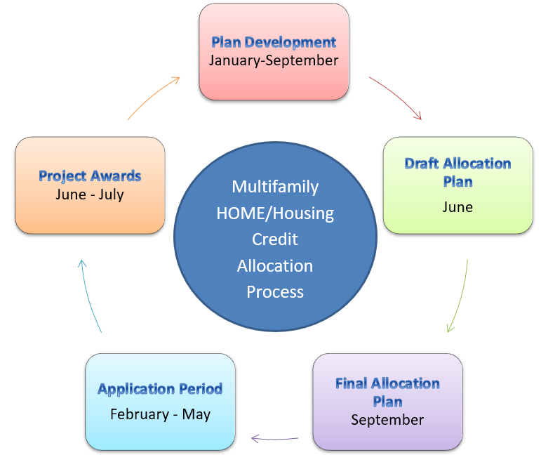
Ahfa competitive application cycle
The AHFA Multifamily Division works on an annual cycle driven by regulatory program deadlines and AHFA quarterly board meetings.
Please Note: The dates provided are estimated and for the purposes of illustration only.

Slide 46
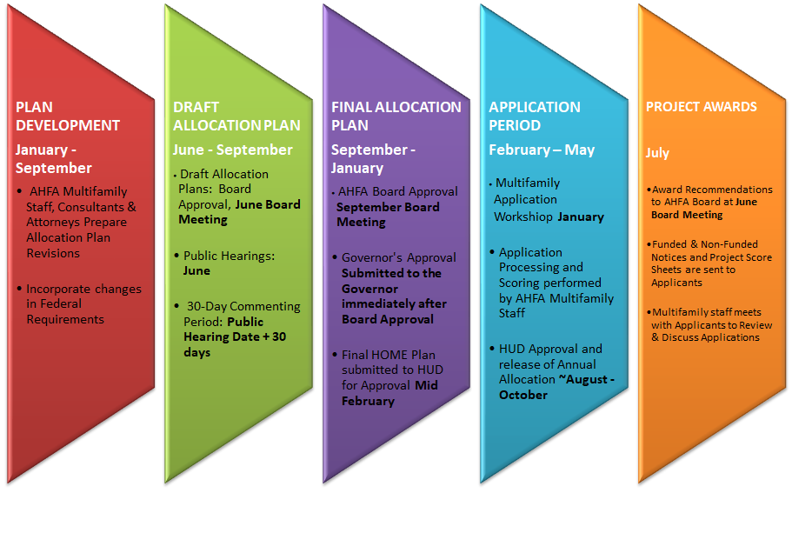
Ahfa competitive application cycle
Please sign up for the AHFA Multifamily Mailing List to receive timely information about cycle dates.
Please Note: The dates provided are estimated and for the purposes of illustration only.

Slide 47
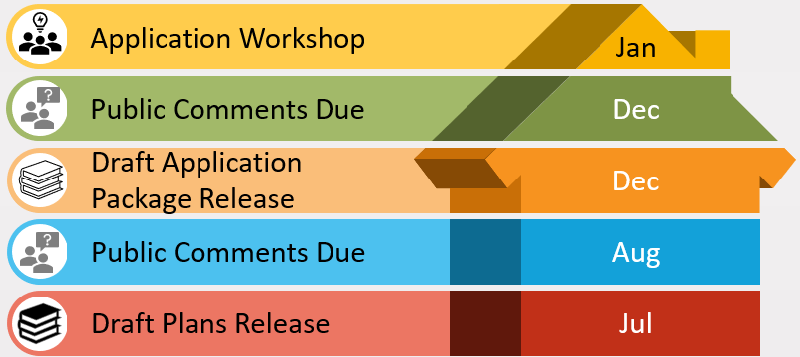
Ahfa competitive application cycle
Public Input is critical to development of the Plans. This input helps to better address the affordable housing needs in the state and provide Plans that work equitably.
This timeline roughly represents the annual timing of the Plan Development process. Actual Release dates and Public Comment deadlines are published via Public Notices and to the AHFA Multifamily Mailing List via Multifamily Notices.
Please Note: The dates provided are estimated and for the purposes of illustration only.

Slide 48
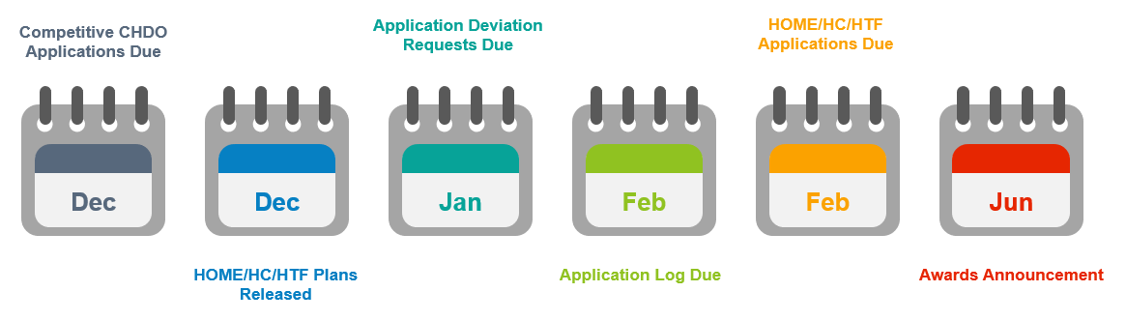
Ahfa competitive application cycle
The application process in Alabama is highly competitive. Generally, only about half of the applications submitted during an annual cycle will receive funding recommendations based on availability of funds.
The Application Cycle Due dates roughly fall in the months indicated but are subject to change. Annual Cycle Due Dates are published prior to each cycle.
Please Note: The dates provided are estimated and for the purposes of illustration only.

Slide 49

Ahfa program compliance
Compliance Monitoring
AHFA's compliance staff periodically inspects each development receiving HOME funds and/or Housing Credits to ensure that it is operating in compliance. Monitoring procedures may include mail-in audits, on-site visits and review of tenant incomes, rent records and living conditions.
Audits are scheduled at random throughout the year. AHFA audits its Housing Trust Fund or Housing Credit financed developments every three years, and its HOME or Bond financed developments every year.
Property owners are responsible for maintaining compliance. AHFA may assist in this effort, but owners should consult their legal or tax counsel for guidance in maintaining compliance with the Internal Revenue Code and program regulations.

Slide 50
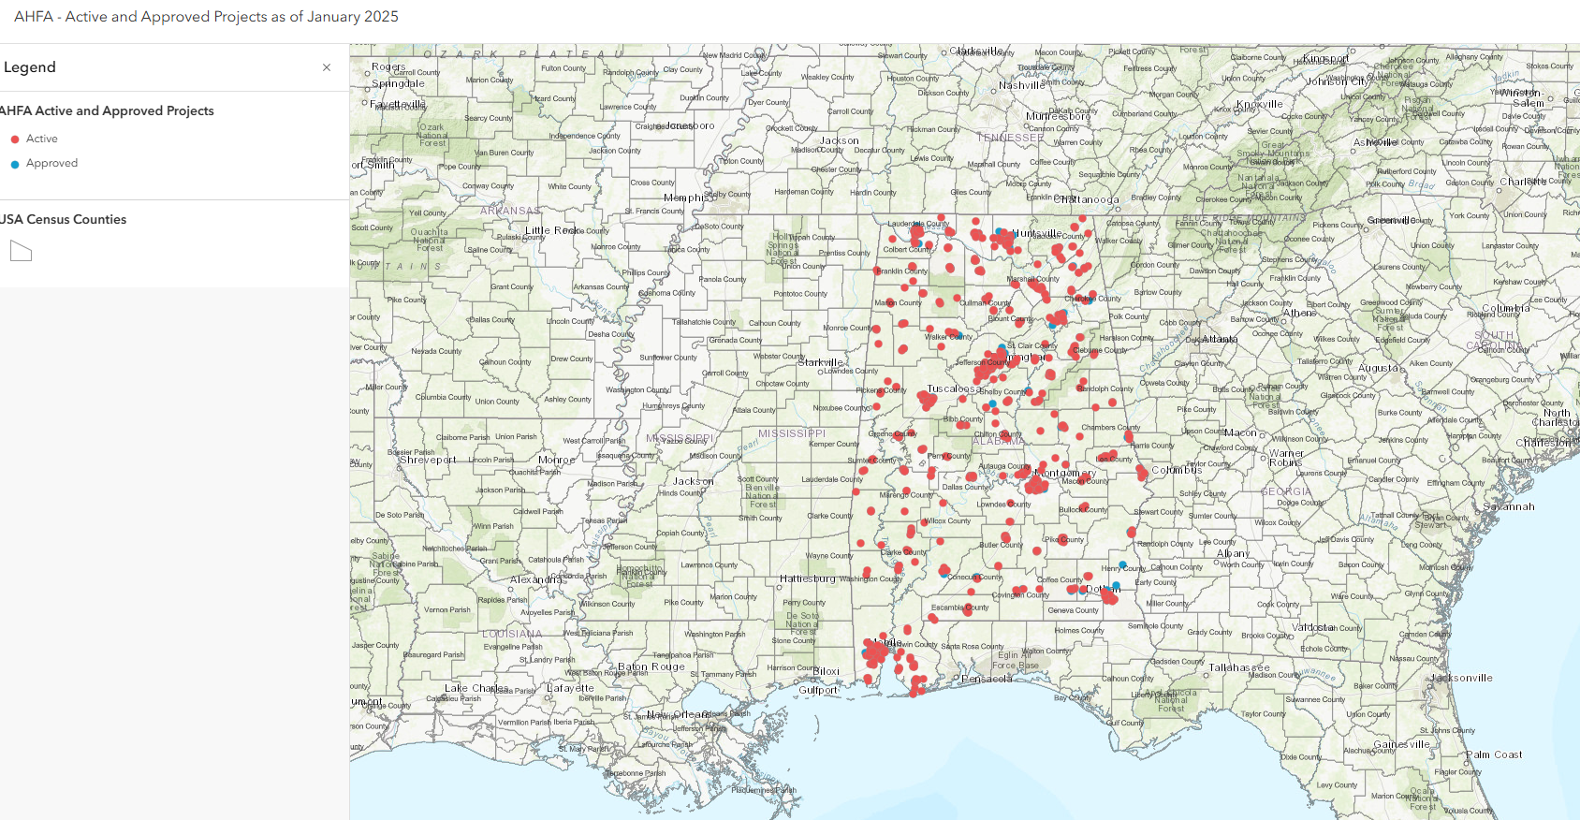
Affordable housing impact in Alabama
AHFA’s Multifamily Division administers over $1 billion in approved and active funding investments to provide affordable rental housing throughout the state.

Slide 51
Developers’ Tips for Success
Participation in the Low-Income Housing Tax Credit (LIHTC) program and other federal housing programs requires significant individual and team experience/expertise, a tolerance for financial risk, and an ability to obtain major banking and credit relationships. We hope hearing from successful AHFA developers will inspire and educate others who are interested in becoming affordable housing owners/developers or increasing their level of experience.

Slide 52

November 13, 2024
Dewayne Richardson
Q: How long have you worked in the affordable housing industry?
About 35 Years
Q: What inspired you to participate in developing affordable housing?
I started out looking at ways to decentralize apartment buildings for affordable housing. My background in being sales manager for one of the largest builders in the community, I had decided to investigate doing single family homes, same concept, with tax credits.
Q: What are the key challenges or barriers to participating in this industry?
The experience is the key factor. That is why it is so important to start out by working with other experienced developers to get the knowledge before going out on their own.
Q: What are some of the challenges that you have experienced along the way that have helped you grow or led to your expertise?
Having the best development team. The professionals that are continually working with other developers and finding those individuals for architect, engineering firms, environmental market studies. Finding the team that is already in place going to use the guidelines of the state agencies is key to developing.
Q: What tips would you give other that may be interested in a career to affordable housing?
Be willing to work as supporting cast to development to gain the knowledge that is required before you go out on your own. That is the key in my opinion. The experience you gain through the experience of others.
Q: Please share any tips to becoming a successful owner or developer.
Relationships. Finding out first what the needs of the community are before you go out to build a mouse trap and there is no mouse. Finding out those needs and tailoring the project toward the needs of the community will ensure your success in the future. \
Q: What do you see as the greatest benefit of affordable housing?
The greatest benefit of affordable housing is being able to compact and identify the needs of your housing expenses. To be around 30% of your income. Most people think affordable housing meaning low income. But affordability is for anyone depending on what area you’re living in to compare to what your incomes are and whether you can afford to work and live in the community where you are located.
Q. Describe your most memorable experience as a developer or your favorite property you’ve been involved in.
Favorite property is the first single family home project that AHFA said you know it makes sense and let s five it a try and to see it was completely leased up 56 units were leased up before we finished construction, and it has a 150% waitlist on those single family homes and being able to convert it now to homeownership is the pride and joy of my development career. Richmond Park.
"Working and building like I said in my experience having been building projects in ga as well. I find that the staff at AHFA recognizes that everyone is not in a big firm with 100 employees that work and put out affordable housing. Being able to work in areas that your tax credit is centered towards 56 units may not be exactly what the big nationwide tax credit developers and affordable housing developers look for because of the economies of scales but AHFA mission is being met by focusing on putting their dollars where it counts in all of Alabama. That is the key and that is why I think the staff is so in tune with the rest of the developers."

Slide 53

August 16, 2024
Marcella Roberts, M. Roberts & Associates
Q: How long have you worked in the affordable housing industry?
A: I have worked in the affordable housing industry for more than 20 years.
Q: What inspired you to participate in developing affordable housing?
A: As a banker, I saw the need for decent, quality housing for working-class families that did not have the means to purchase a home or rent market-rate housing. As a child, I grew up in a family with limited means, so we didn't have many options for quality housing in nice neighborhoods. However, I always believed that every child should have a nice, safe place they are proud to call home. I am honored that I get to make that a reality for so many families today.
Q: What are the key challenges or barriers to participating in this industry?
A: One key challenge today is a lack of information available and marketing to college students about the affordable housing industry as a valuable career choice. Another barrier is the lack of access to capital to support the financial requirements to carry a project from application to lease-up. The access to capital barrier prevents the affordable housing industry from being adequately represented by the gender, racial, ethnic and age groups that it serves.
Q: What are some of the challenges you've experienced along the way that have helped you grow and led to your expertise?
A: I'm grateful to have great mentors on this affordable housing journey, but one challenge that helped me grow was understanding the value of inclusion and partnerships in this industry: Inclusion, effective communication, and partnership within the industry and externally with those we serve. This can make the difference between "just an apartment complex" and the development of a strong community.
Q: Please share any tips to becoming a successful owner and/or developer.
A: Develop a willingness to persevere through the hard times because success is on the other side. Be willing to train, mentor and bring others along the journey with you; it's no fun celebrating alone.
Q: What tips would you give others who might be interested in a career in affordable housing development?
A: Make sure you are passionate about affordable housing. It's more than making money; people's lives are at stake. Be prepared for the unexpected; every day is different.
Q: What do you see as the greatest benefit of affordable housing?
A: The greatest benefit to affordable housing is the actual creation of decent, safe, quality housing for working class families that will positively impact lives for years to come.
Q: Describe your most memorable experience as a developer or your favorite property you’ve been involved with.
A: My most memorable experience was the redevelopment of the Loveman Village property (now Villas at Titusville) in Birmingham, Alabama. The property is located near the neighborhood where I grew up. During my earlier years, I witnessed a beautiful, highly desired property for diverse families moving from segregated row houses. Loveman Village was built in 1952 with indoor plumbing, insulation, nice amenities and full brick in the middle-income neighborhood known as Titusville. Over the years due to improper maintenance and poor management, it became the eyesore of the west side, with crime and blight. Upon being chosen as the developer, and after seven years and three phases of development, the new home to more than 250 families was complete. Many long-term residents shed tears of joy as they walked into their new homes.
Q: Is there anything else that you would like to include?
A: Many thanks to the Alabama Housing Finance Authority for the LIHTC program and the many ways you support the industry to make affordable housing a reality for families in Alabama.

Slide 54

May 25, 2021
Ann Marie Rowlett, partner and COO at The Bennett Group, LLC
Q: How long have you worked in the affordable housing industry?
A: I began working in affordable housing in July 2002.
Q: What inspired you to participate in developing affordable housing?
A: At first, it was just a new job and something I had no experience doing. As time went on, I learned more about the processes, funding sources available for this housing, and the amazing difference that this housing can provide in the lives of the population that need it most. This housing fills a large demand for those families and individuals that make too much money to live in public housing yet cannot afford rents in conventional multifamily housing. Seeing the end product, which is always beautiful, is such a blessing to the community in which it’s located as well as the tenants who reside there. We always invite tenants to speak at our open house functions. Listening to their stories and how much this housing means to them is worth all the effort that it takes to get there.
Q: What tips would you give others who might be interested in a career in affordable housing development?
A: It is a very steep learning curve and is very complicated. But if you can give it 3 years - which is approximately the time it takes to go from locating a site to having tenants move in - then you can do it. Also, creating strong relationships with banks that deal in affordable housing and quality equity investors is a must.
Q: What about tips when it comes to being a successful owner and/or developer?
A: The biggest tip is to make as many contacts as possible. First, having a strong, dependable and responsive management company is imperative. The more professionals that you know and have rapport with, the more successful you will be. This industry takes a village to manage. No one can do it alone. Relationships that developers/owners can establish with knowledgeable, reputable, and trustworthy general contractors, accountants, attorneys, architects, engineers, market analysts, environmental professionals, etc., can make or break a successful housing development.
Q: What do you see as the greatest benefit of affordable housing?
A: Giving people who otherwise wouldn’t have the ability to live in beautiful, affordable housing that is safe, sanitary, and located close to jobs, shopping, medical facilities, schools, and worship facilities.
Q: Anything else you’d like to include?
A: The low-income housing tax credit program started in 1986 and has been the most successful source of affordable housing production in history. I hope that all the developers/owners out there will continue to do all that is necessary to make this program continue to be a success. Additionally, none of this would be at all possible without our state housing finance agencies who work tirelessly to continue making this program available.

Slide 55

September 03, 2021
Fred Bennett, managing partner and chief financial officer with The Bennett Group, LLC
Q: How long have you worked in the affordable housing industry?
A: I began working to organize migrant farm workers into self-help housing groups as a VISTA volunteer in the Fort Myers area of Florida in 1967. I knew and worked with migrant families there who lived in shacks with no plumbing, and some even slept under the produce trailers with their kids. That’s when I felt a calling to develop affordable housing, and I’ve been working as an affordable housing developer ever since.
Q: What are the key challenges or barriers to participating in this industry?
A: Ours is a niche industry requiring knowledge of Section 42, HOME, HTF, and other federal programs that change from year to year. One must keep up with this in addition to following good real estate development practices in various locations. The costs are high to bring a project-funding application together and the selection process is highly competitive. Developers need enough capital to compete and to keep their team together between jobs. Meeting ever-increasing environmental regulations is expensive and challenging. Since last year, supply shortages and very rapidly escalating costs for materials have been the greatest challenge.
Q: What tips would you give others who might be interested in a career in affordable housing development?
A: I think the best way to start, perhaps the only way, is as an employee working with an affordable housing developer.
Q: Share any tips to becoming a successful owner and/or developer?
A: There are no “Lone Ranger” developers, and The Bennett Group is no exception. Internally, we work as a team. The process is complex and also requires a team of third-party professionals who communicate and work well together. A good developer works a lot like the conductor of an orchestra – he or she identifies talented professionals, inspires them with a common mission, and communicates constantly, trying to draw the best from them. This all has to be done within a budget and a timeframe, and it must be done with a supportive “win-win” attitude toward all involved.
Q: What do you see as the greatest benefit of affordable housing?
A: There’s a gladness we share with residents when they first see their new apartments. Many are astonished to see a quality of housing they thought they never could afford. But the greatest benefit is seeing these new neighbors become real neighbors over time and becoming a healthy community.
Q: Anything else you’d like to include?
A: For a few years, in addition to my development activity, I worked on the acquisitions team for a syndicator and had the opportunity to meet developers in several states, attend their state housing conferences and learn how the various state agencies operated. Alabama has one of the best state housing finance authorities in the nation, some of the best developers, and one of the best looking and best managed affordable housing portfolios in the country. Our trade group, the Alabama Affordable Housing Association is, I believe, the top group in the country.

Slide 56

April 05, 2022
Clarence Ball is the president/CEO of Ball HealthCare Services, Inc.
Q. How long have you worked in the affordable housing industry?
A. My career in affordable housing began in 1973, while studying to complete a master’s degree in long-term care administration. That was when I first was introduced to various HUD products used to finance senior housing for skilled, custodial, and independent living facilities. After successful completion of the master’s program, I worked as a licensed nursing home administrator for 10 years. I formed Ball HealthCare in 1983, with a mission to go to underserved areas and develop quality services for seniors and special needs population groups. I was able to use the lessons I learned during my fellowship to expand beyond our nursing home footprint into affordable housing. I began applying for affordable housing projects in the late 90s, and in 2003 we opened Cherry Ridge Apartments in Birmingham as our first independent living apartment project. Since then, we have been able to repeat this model in other parts of the state.
Q. What are the key challenges or barriers to participating in this industry?
A. A key challenge is that the need for quality housing is far greater than the available resources needed to build affordable housing. Thus, the competition is fierce among developers. Moreover, the use of tax credit financing can be complex. The application process alone is expensive, time consuming, and gaining an award is not guaranteed. These are highly specialized programs with their own set of rules, regulations, and tax code. To be competitive, you must have vision, development and operational know-how, capital, and a high tolerance level for risk. It takes experience, a respected track record, and the assembly of a team of highly talented professionals with expertise in different areas to be successful.
Q. What are some of the challenges you’ve experienced along the way that have helped you grow and led to your expertise?
A. Overcoming failure is the most difficult challenge. Persistence matters. I was not successful in receiving awards until my third application but treated each failure as a learning lesson. Another challenge is assembling and working with the right team. This is one business where success means recognizing your own limitations and the skills of other team members. While one person alone can’t make you successful, a single wrong team member can bring failure.
Q. What tips would you give others who might be interested in a career in affordable housing development?
A. People who are interested in participating should establish a track record in development, and particularly, senior housing. They can partner with or work for an experienced tax credit developer. That is what I did after my early disappointments. I set out to find the top developer in the state, partnered up, and together, we have completed 13 affordable housing projects.
Q. Please share any tips for becoming a successful owner and/or developer.
A. Again, success requires patience, capital, and most of all fielding a winning team of highly talented professionals. Becoming a successful developer doesn’t mean you do it all yourself. You can’t. Before getting into affordable housing, I had substantial experience in developing healthcare facilities. I knew about needs assessments and screening applicants for income because we do that for Medicaid, Medicare, and other government programs. But I needed tax credit expertise to be successful in the affordable housing industry. You have got to have a great team comprised of a strong program specialist, lawyer, architect, engineers, CPA, contractors and bankers, each with a depth of affordable housing knowledge and experience. You want to work with people who are the best at what they do.
Q. What do you see as the greatest benefit of affordable housing?
A. Affordable housing has been an outreach of Ball HealthCare’s mission of providing quality services and improving lives in underserved areas. The greatest benefit I see is improving the quality of life for low- and moderate-income families who have a legacy of living in substandard conditions. It is tremendously rewarding to see the happiness and excitement on the faces of our tenants when they move in. Many of them will tell you, “I never thought I’d be able to afford a home like this.”

Slide 57

June 01, 2022
Herschell Hamilton & Mike Carpenter, Bloc Global Group
Q: How long have you worked in the affordable housing industry?
A: We initiated our first affordable project in 2006. This was a 100-unit apartment project in the Oxmoor Valley area of Birmingham. This project was delivered in partnership with Pennrose Properties of Philadelphia, Pennsylvania, and the Housing Authority of the Birmingham District (HABD).
Q: What inspired you to participate in developing affordable housing?
A: We became aware of the tremendous need for quality affordable and workforce housing at that time, and decided to focus time, attention, and resources to fill the need. To our knowledge in 2006, there were not many diverse firms domiciled in Alabama developing affordable housing, and we saw this as a way to serve our community.
Q: What are the key challenges or barriers to participating in this industry?
A: As with many diverse businesses, the greatest challenge is access to capital, and access to a track record needed to support application for funding from state and/or federal sources. Lack of access to capital is a compounded challenge for real estate developers, as projects require a developer to carry the financial burden for a project for two years or more before you get to a financial closing, where you begin to recover your costs and build toward project profitability.
Q: What are some of the challenges you’ve experienced along the way that have helped you grow and led to your expertise?
A: We were able to overcome the initial access to capital and track record challenges by doing strategic partner sourcing. We identified a firm that shared our passion for development in this area and worked with them to build our internal capacity and expertise over the long term. When we compete for projects, we work to understand local political and civic influences, which can sometimes be challenging, but we always pull together the best team to make a compelling case for our selection. Developing projects with Department of Housing and Urban Development (HUD) funding to public housing authorities using low-income housing tax credits (LIHTC) can be a complicated process. Again, we have teamed with national partners to help us navigate the requirements and in doing so have developed the expertise in-house.
Q: Please share any tips to becoming a successful owner and/or developer.
A: You must be assertive in your hunt for projects, and patient as you move through the development process (which includes project modeling, site due diligence, site acquisition, project funding, project construction, and project occupancy). From start to finish, a typical project could take 2-4 years before tenants occupy your development. You must have a strong team AND be well capitalized! This is an incredibly competitive industry. Be flexible and nimble. Real estate development is inherently full of unexpected challenges.
Q: What do you see as the greatest benefit of affordable housing?
A: Our developments provide quality housing options for working class families to live and raise their families in stable and neighborly environments. There is a dignity associated with a loving home, and families often need additional support to get on their feet and move toward true self-sufficiency. We vividly remember an energetic and spirited elderly woman in Memphis. At our ribbon cutting for the new senior housing development and with tears in her eyes, Ms. Jones said “I never thought in my wildest dreams that I would ever live in a home this nice.” As developers, we have a role in creating housing that makes life better for others. That is our greatest reward!
Q: Is there anything else that you would like to include?
A: We are enormously proud of the work that we do. To date, we have successfully participated in the delivery of over 3,000 housing units, both family and senior developments throughout the southeast United States. We appreciate the support of our public partners, public housing authorities, and state finance agencies like AHFA.

Slide 58
Stay connected with AHFA
Alabama Housing Finance Authority Website- AHFA provides homeowner and rental opportunities for Alabamians. The AHFA website provides details on all the Programs administered by AHFA. www.ahfa.com
AHFA Annual Reports- Our work shows us every day that affordable housing transforms communities and drive local economies. Annual Reports | Alabama Housing Finance Authority (ahfa.com)
AHFA Monthly Newsletter- News | Alabama Housing Finance Authority (ahfa.com)
AHFA Multifamily Notices- Multifamily Notices | Alabama Housing Finance Authority (ahfa.com)

