Slide 1

NSPIRE
This Photo by Unknown Author is licensed under CC BY

Slide 2
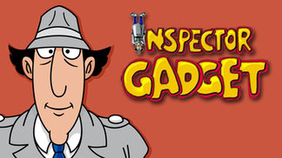
NSPIRE
What is NSPIRE?
National Standards for the Physical Inspection of Real Estate
NSPIRE has Three (3) Inspectable Areas:
Unit
Inside
Outside
This Photo by Unknown Author is licensed under CC BY-SA

Slide 3
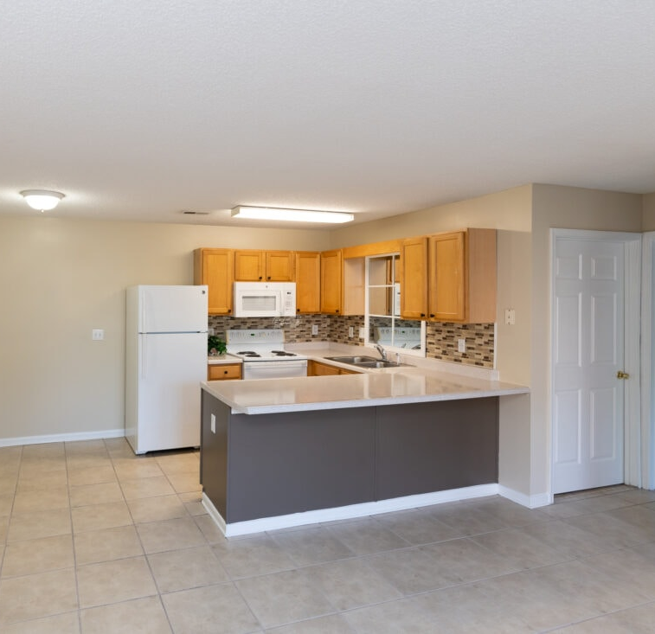
NSPIRE
Unit
A “Unit” of HUD housing refers to the interior components of an individual dwelling, where the resident lives.
This Photo by Unknown Author is licensed under CC BY-NC-ND

Slide 4

NSPIRE
INSIDE
“Inside” refers to the common areas and building systems within the building interior and are not inside a unit. This could include interior laundry facilities, workout rooms, and so on.

Slide 5
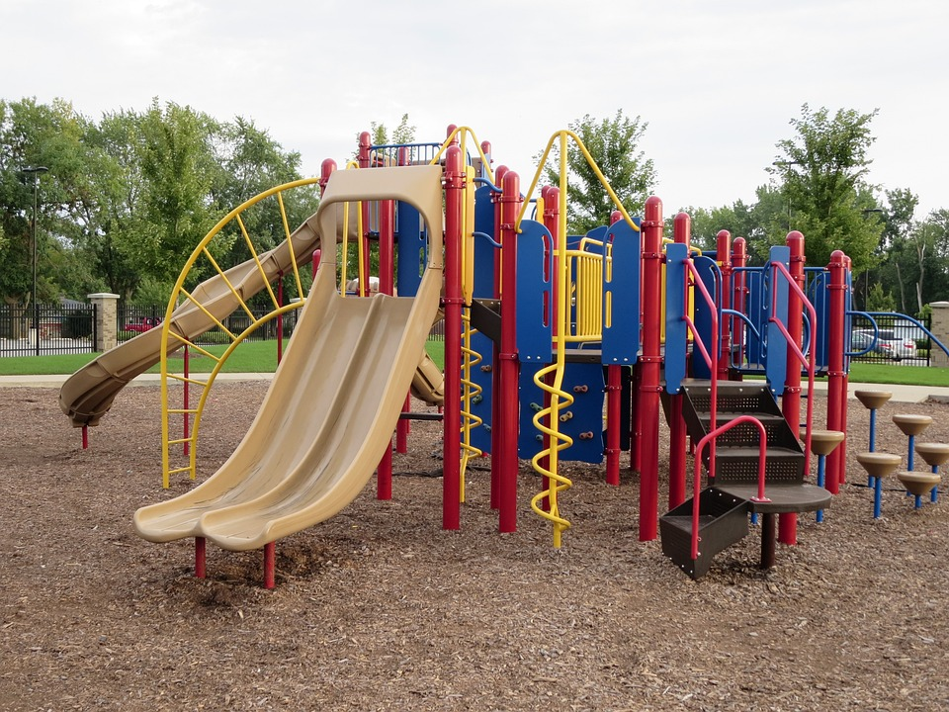
NSPIRE
OUTSIDE
“Outside” refers to the building site, building exterior components, and any building systems located outside of the building or unit. This includes things like playgrounds, sidewalks, and air-conditioning units.

Slide 6

NSPIRE
AHFA is currently and has been using NSPIRE Standards for the physical inspection process since 2024.

Slide 7

NSPIRE Standards
The standards can be found by searching the HUD website or using the following link:
National Standards for the Physical Inspection of Real Estate (NSPIRE) | HUD.gov / U.S. Department of Housing and Urban Development (HUD)
This Photo by Unknown Author is licensed under CC BY-SA-NC

Slide 8

NSPIRE Facts
Inspections are taking longer.
Average 56-unit property
12 units are inspected
In the past, this would take AHFA about 1-hour
Now, it takes 2-hours (sometimes longer)

Slide 9
NSPIRE Facts
Different areas of the unit are being inspected. Here are a few, but this is NOT the complete list:
Windows
Stove
Oven
Eyes
All Electric Outlets
All GFCI Outlets
Bathroom Sink(s)
Bathroom Shower/Tub
Water Heater
Balcony
Fire Extinguisher
Cabinets and Drawers

Slide 10
NSPIRE Facts
Correction Timeframe is based on the finding.
24-Hours
30-Days
60-Days

Slide 11
NSPIRE Requirement for AHFA Properties
Management Must Participate in the inspection
It is very important to have Maintenance present or at least in the area so that any 24-hour correction can be made
Make sure your Maintenance is familiar with the NSPIRE Standards

Slide 12
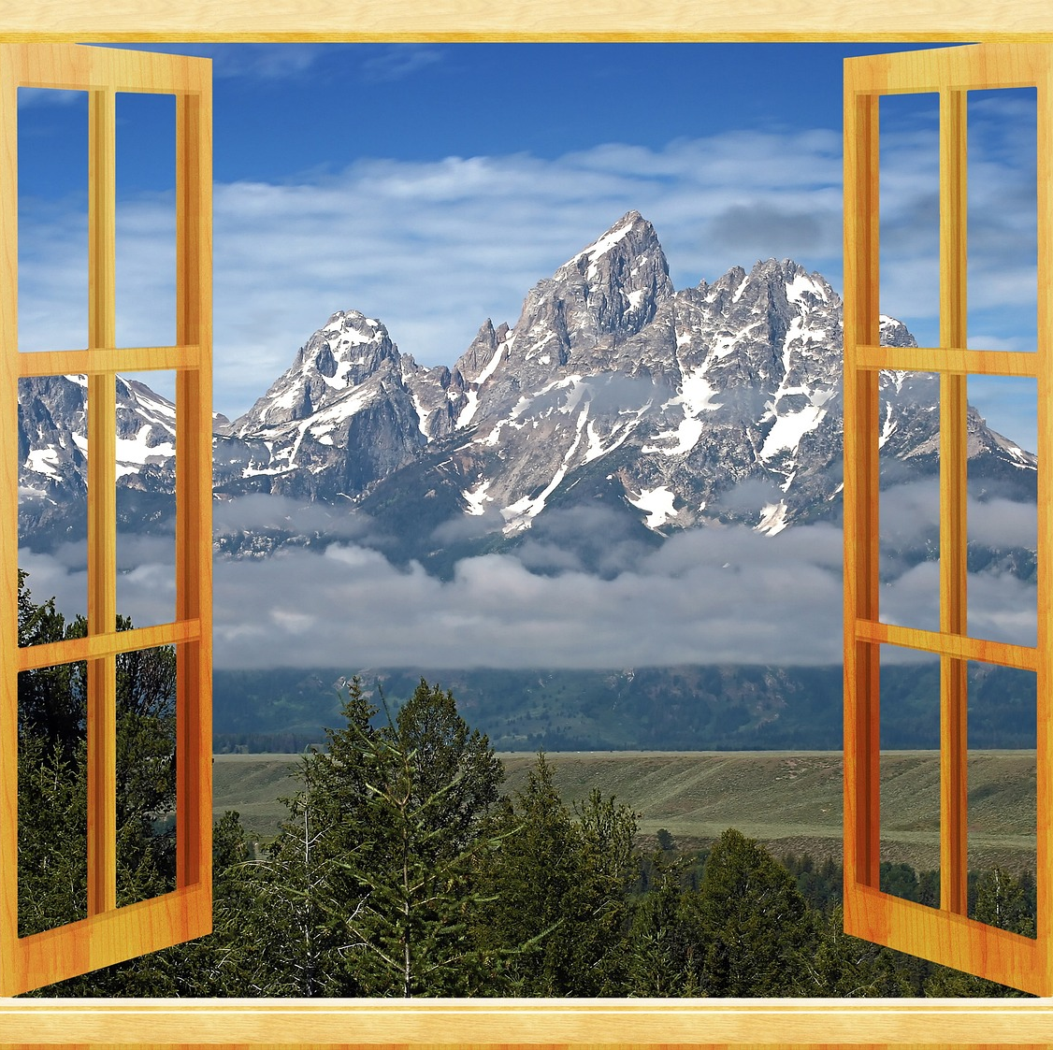
NSPIRE Standards - Example
Window Standard
DEFICIENCY CRITERIA:
Window will not open.
OR
Once opened, window will not stay open without the use of a tool or item.

Slide 13
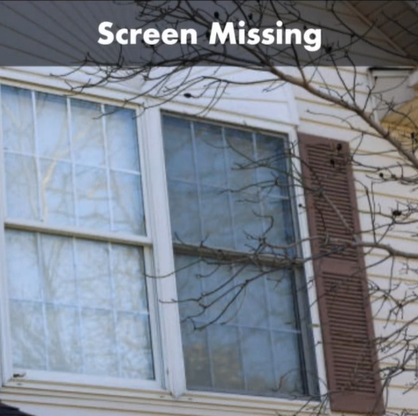
NSPIRE Standards - Example
Are Missing Window Screens a NSPIRE Deficiency?
Yes
If there is evidence that the window should have a screen

Slide 14
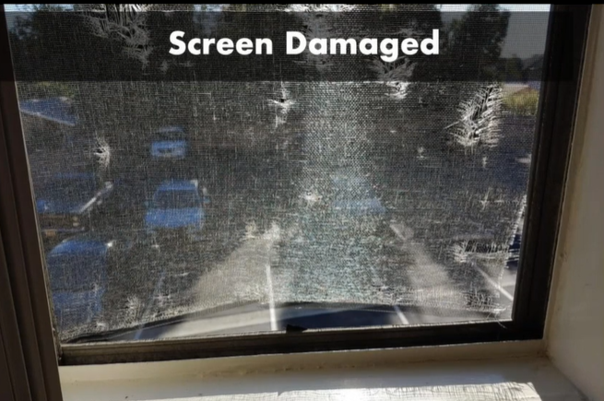
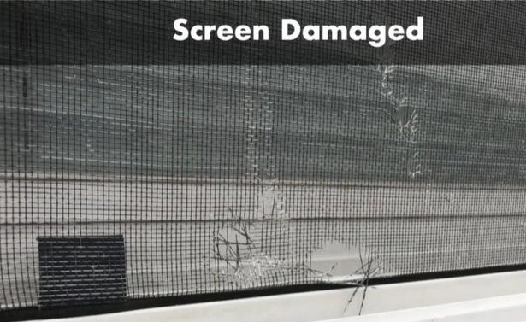
NSPIRE Standards - Example
Are Damaged Window Screens a NSPIRE Deficiency?
Yes
Damage must be greater than 1 in.

Slide 15
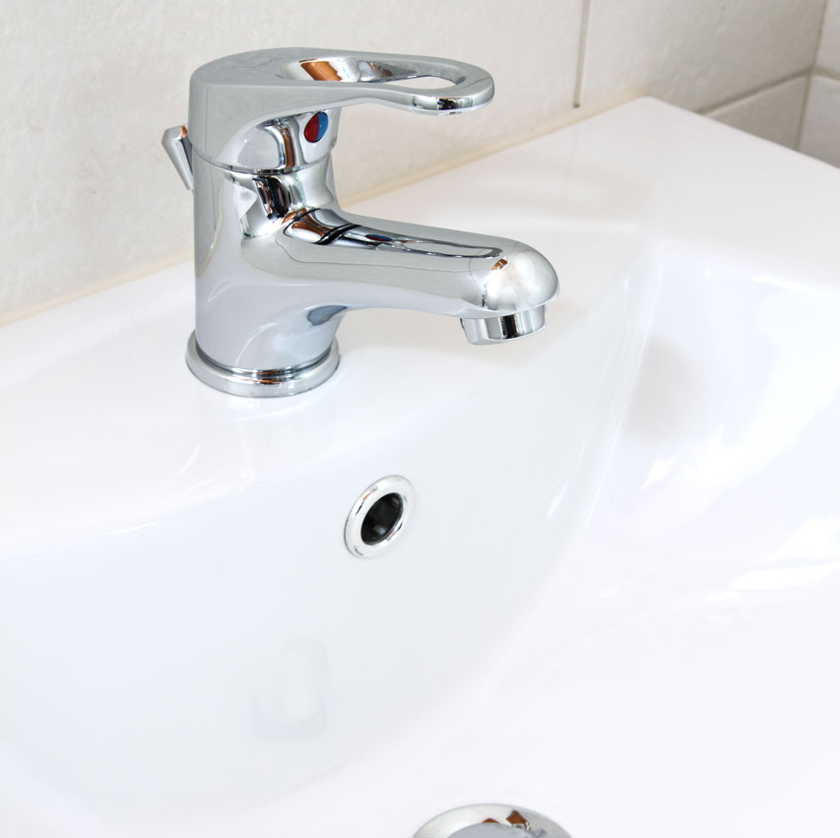
NSPIRE Standards - Example
Sink Standard
DEFICIENCY CRITERIA:
Sink or sink component is damaged (i.e., visibly defective; impacts functionality) or missing (i.e., evidence of prior installation, but now not present or is incomplete) and the sink is not functionally adequate.

Slide 16
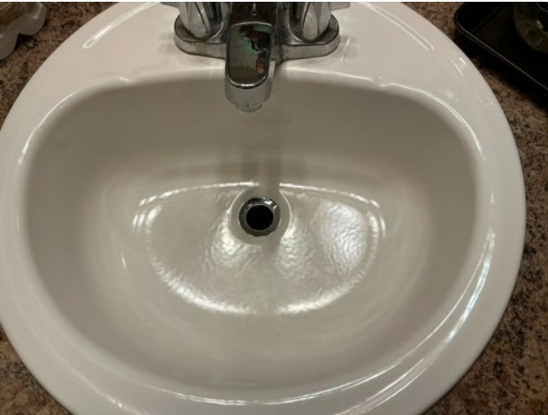
NSPIRE Standards - Example
Is this a NSPIRE Deficiency?
Yes

Slide 17
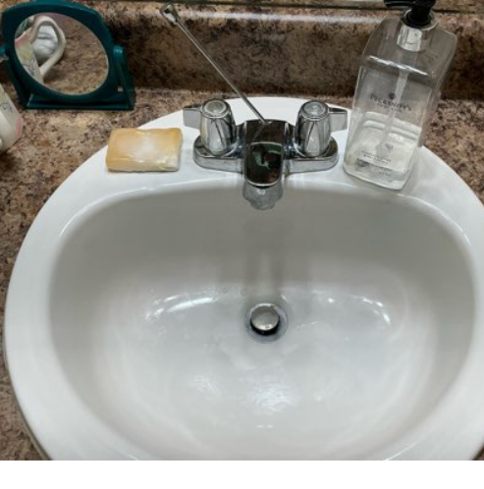
NSPIRE Standards - Example
Is this a NSPIRE Deficiency?
Yes

Slide 18
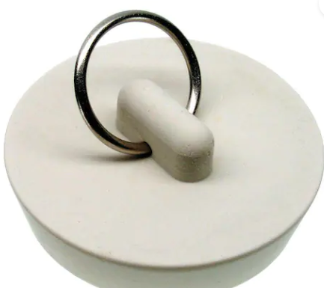
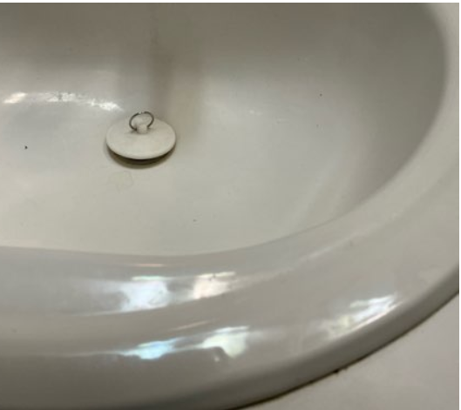
NSPIRE Standards - Example
Is this a NSPIRE Deficiency if used in a sink?
No
However, it must allow the sink basin to retain water. It must fit the size of the drain.

Slide 19
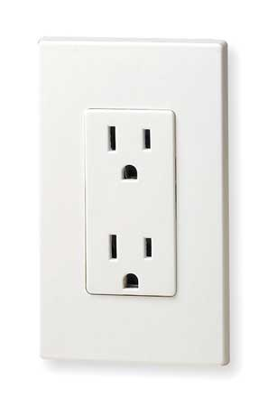
NSPIRE Standards - Example
Electrical Outlet
DEFICIENCY CRITERIA:
Any portion of a visually accessible (i.e., can be reasonably accessed and observed) outlet or switch is damaged (i.e., visibly defective; impacts functionality) such that it may not safely carry or control electrical current at the outlet or switch.
OBSERVATION:
Identify all outlets and switches.
Look at each outlet and switch for signs of damage (e.g., smoke, burn marks, arcing).
This Photo by Unknown Author is licensed under CC BY-SA

Slide 20
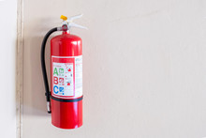
NSPIRE Standard - Examples
Deficiency Criteria:
Pressure gauge indicates that the fire extinguisher is over or under-charged.
The date on the service tag of any fire extinguisher has exceeded one year.
The fire extinguisher tag is missing or illegible.
A nonchargeable or disposable fire extinguisher is more than 12 years old (based on manufacture date).
Fire extinguisher is damaged (i.e., visibly defective; impacts functionality).
Fire extinguisher is missing (i.e., evidence of prior installation, but now not present or is incomplete).

Slide 21
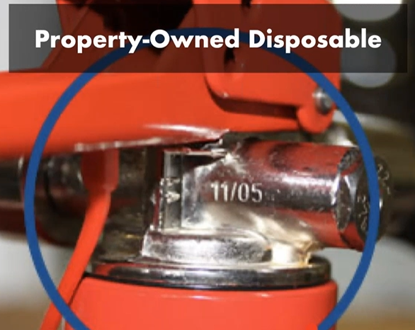
NSPIRE Standard - Examples
Is this a NSPIRE Deficiency if the inspection was performed May 22, 2025?
Yes

Slide 22
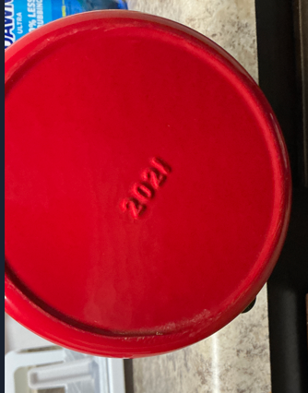
NSPIRE Standard - Examples
Is this a NSPIRE Deficiency if the inspection was performed May 22, 2025?
No

Slide 23
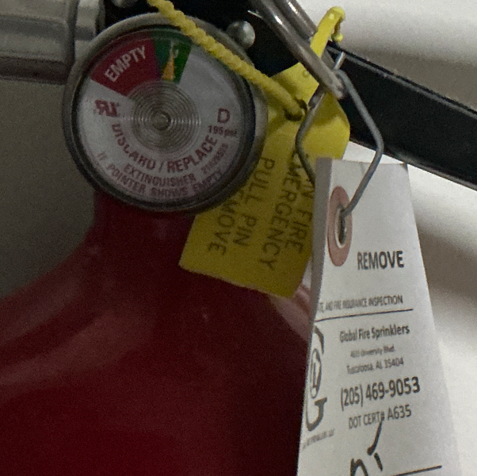
NSPIRE Standard - Examples
Does this Fire Extinguisher require an annual inspection?
No
It is good for 12-years based on the manufacturing date that will either be on the neck or bottom of the fire extinguisher

Slide 24
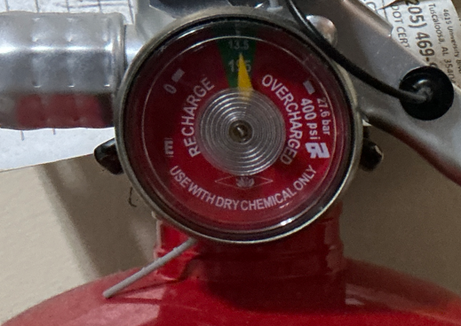
NSPIRE Standard - Examples
Does this Fire Extinguisher require an annual inspection?
Yes

Slide 25
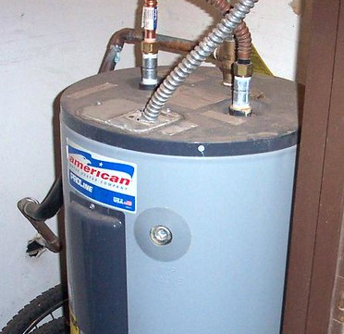
NSPIRE Standard - Examples
Water Heater
If the water heater is located behind a locked door or concealed, request access from the resident or management.
This Photo by Unknown Author is licensed under CC BY-NC-ND

Slide 26
NSPIRE Standard - Examples
Water Heater
DEFICIENCY 1 – UNIT:
TEMPERATURE PRESSURE RELIEF (TPR) VALVE HAS AN ACTIVE LEAK OR IS OBSTRUCTED OR RELIEF VALVE DISCHARGE PIPING IS DAMAGED, CAPPED, HAS AN UPWARD SLOPE, OR IS CONSTRUCTED OF UNSUITABLE MATERIAL.
DEFICIENCY CRITERIA:
TPR valve has an active leak.
TPR valve is obstructed such that the TPR valve is unable to be fully actuated.
Relief valve discharge piping is damaged (i.e., visibly defective; impacts functionality), capped, has an upward slope, or is constructed of unsuitable material.

Slide 27
NSPIRE Standard - Examples
DEFICIENCY 2 – NO HOT WATER
INSPECTION PROCESS:
Turn the faucet handle to activate hot water.
Feel the water coming out of the faucet to determine if it is heating up.
DEFICIENCY 3 – THE RELIEF VALVE DISCHARGE PIPING IS MISSING OR TERMINATES GREATER THAN 6 INCHES OR LESS THAN 2 INCHES FROM WASTE RECEPTOR FLOOD-LEVEL.
DEFICIENCY CRITERIA:
The relief valve discharge piping is missing (i.e., evidence of prior installation, but is now not present or is incomplete).
The relief valve discharge piping terminates greater than 6 inches or less than 2 inches from waste receptor flood-level.

Slide 28
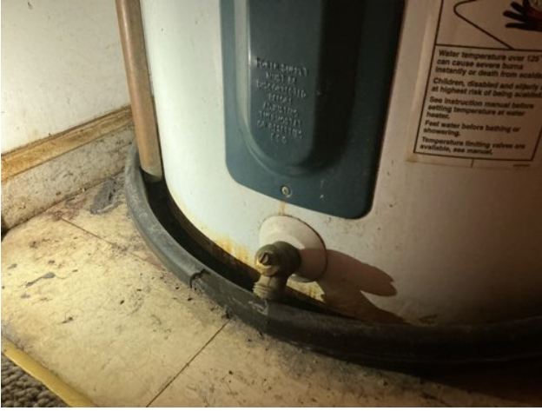
NSPIRE Standard - Example
Is this a NSPIRE Deficiency?
Yes
The Relief Valve Discharge Piping terminates greater than 6 in. or less than 2 in. from Waste Receptor Flood-Level.

Slide 29
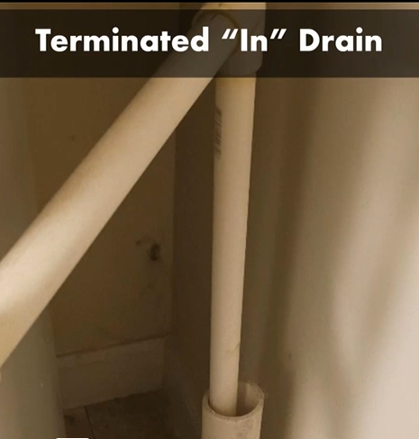
NSPIRE Standard - Example
Is this a NSPIRE Deficiency?
Yes
The Relief Valve Discharge Piping is less than 2 in. from Waste Receptor Flood-Level.

Slide 30
NSPIRE Standard - Examples
Egress Issue
Only apply to the bottom 3-floors of a project.
Areas of Concern:
Exterior Doors
Bedroom Doors
Bedroom Windows

Slide 31
NSPIRE Standard - Examples
DEFICIENCY 1 – OBSTRUCTED MEANS OF EGRESS
DEFICIENCY CRITERIA: The exit access or exit is obstructed.
An exit access is a path from any interior location to an exit.
An exit is a door to the outside or enclosed exit stairway.

Slide 32
NSPIRE Standard - Examples
DEFICIENCY 2 – SLEEPING ROOM IS LOCATED ON THE 3RD FLOOR OR BELOW AND HAS AN OBSTRUCTED RESCUE OPENING.
INSPECTION PROCESS:
The following are examples of conditions that may obstruct a rescue opening:
Window locks that require a key, a tool, or special knowledge or effort to operate (from the interior).
When fixed security bars are present that cover a window that is the designated rescue opening from the building.
Any lock on movable security bars for windows requiring a key (special tool) to open, whether locked or unlocked at the time of inspection.
Placement of an item or furniture that is not resident owned and obstructs a rescue opening.
A permanently installed window-mounted air conditioner.
Resident-owned property should not be evaluated as an obstruction to the rescue opening.

Slide 33
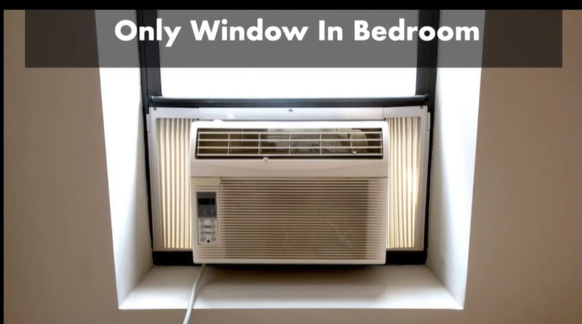
NSPIRE Standard - Example
Is this an egress issue?
The bedroom has 1-window.
Yes

Slide 34
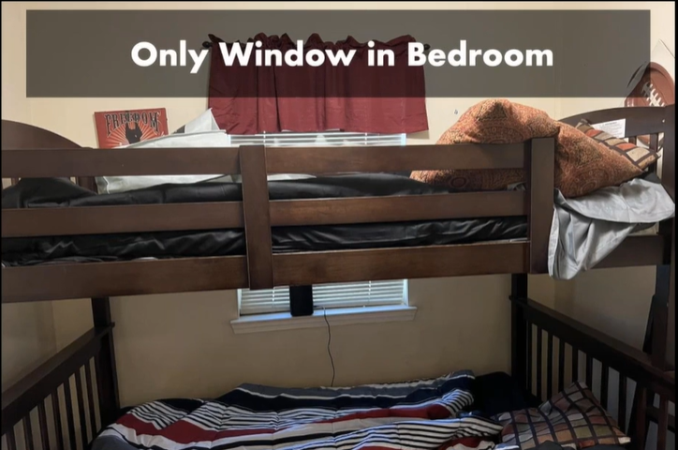
NSPIRE Standard - Example
Is this an egress issue?
The bedroom has 1-window.
No
Resident Owned Property

Slide 35

NSPIRE Standard - Example
DEFICIENCY 1 – UNIT: EVIDENCE OF COCKROACHES.
DEFICIENCY CRITERIA:
Evidence of cockroaches is found (i.e., a live or dead cockroach, shed skins, droppings, or egg cases).
OBSERVATION:
Look for a dead or live cockroach, shed skins, droppings (small black specks or smears), and egg cases (brown oblong cases: 5–9mm long).
This Photo by Unknown Author is licensed under CC BY-SA-NC

Slide 36
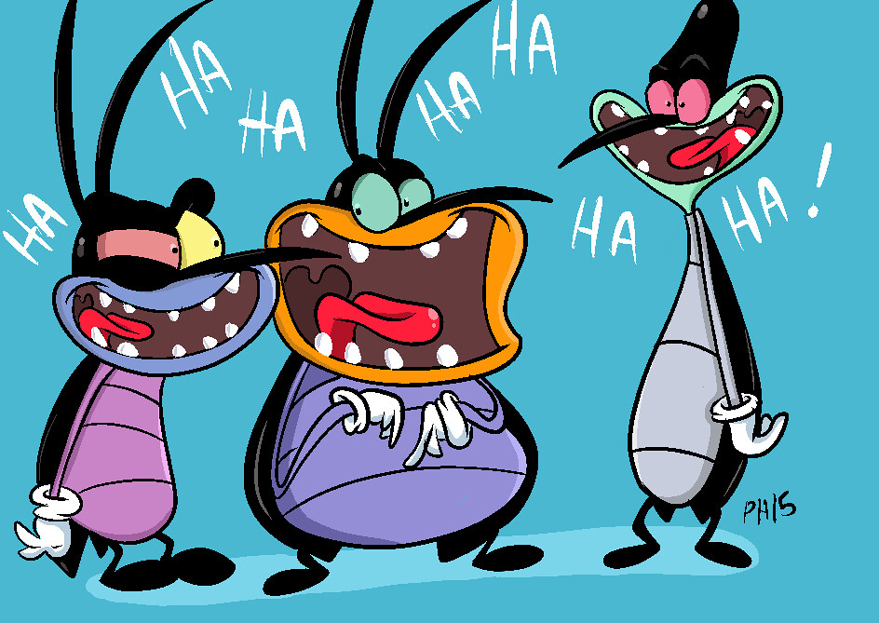
NSPIRE Standards – Example
DEFICIENCY 2 – UNIT: EXTENSIVE COCKROACH INFESTATION.
DEFICIENCY CRITERIA:
Sighting of at least one live cockroach in two or more Units during a daytime surface visual assessment.
Sighting of at least one live cockroach in two or more rooms in a Unit during a daytime surface visual assessment.
OBSERVATION:
Look for any live cockroach.
At least one live cockroach in two or more Units during a daytime surface visual assessment is a sign of extensive infestation.
At least one live cockroach in two or more rooms in a Unit during a daytime surface visual assessment is a sign of extensive infestation.
This Photo by Unknown Author is licensed under CC BY

Slide 37
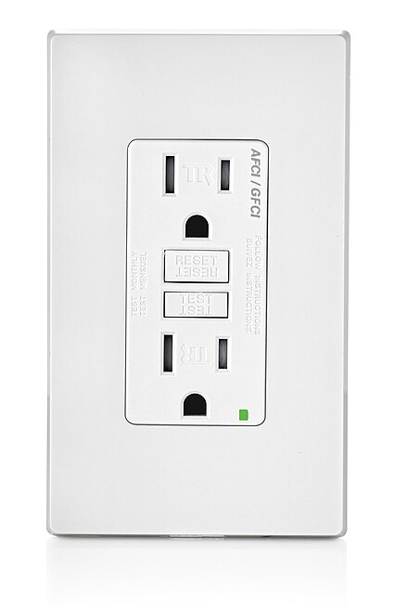
NSPIRE Standard - Example
DEFICIENCY 3 – UNIT: AN UNPROTECTED OUTLET IS PRESENT WITHIN SIX FEET OF A WATER SOURCE.
DEFICIENCY CRITERIA:
Outlet is present within six feet of a water source (i.e., sink, bathtub, shower, water faucet, toilet) located in the same room.
AND
Outlet is not GFCI protected.
OBSERVATION:
Identify all outlets within the Unit.
Identify water sources (i.e., sink, bathtub, shower, water faucet, toilet) within the same room as each outlet.
Determine if each outlet within six feet of a water source is GFCI protected.
This Photo by Unknown Author is licensed under CC BY-SA

Slide 38
NSPIRE Standard - Example
MORE INFORMATION:
- Outlet protection methods include GFCI outlet, GFCI breaker, or an outlet wired in series that is protected by another GFCI outlet.
- An outlet dedicated to a major appliance (e.g., water heater, HVAC, refrigerator, washing machine, dishwasher, garbage disposal, appliance that is wall-mounted or installed within a cabinet, etc.) should NOT be evaluated under this standard, regardless of its distance from the water source.
- A dedicated outlet is a receptacle outlet that is only capable of serving that specific appliance.
- An outlet located below a countertop and within an enclosed cabinet should not be evaluated under this standard, regardless of its distance from the water source.
- An electrical conductor that is not enclosed or properly insulated should be evaluated under the Electrical – Conductor, Outlet, and Switch standard.
This Photo by Unknown Author is licensed under CC BY-SA

Slide 39
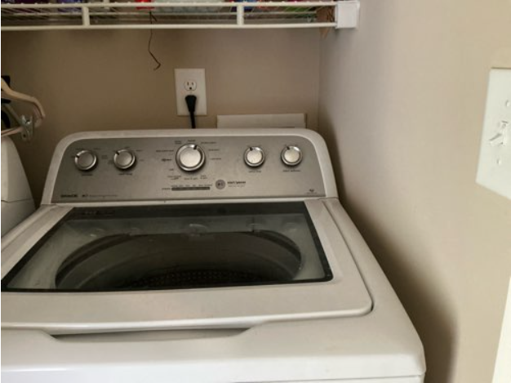
NSPIRE Standard - Example
Is this a NSPIRE Deficiency?
Yes
If the outlet is not GFCI protected.

Slide 40
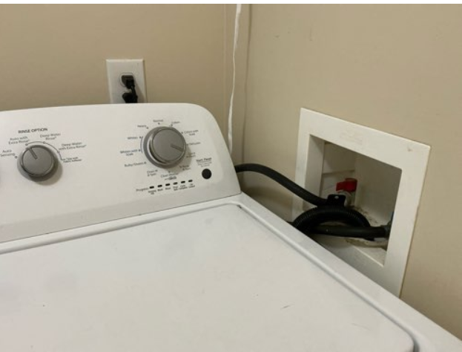
NSPIRE Standard - Example
Is this a dedicated outlet?
No

Slide 41
NSPIRE Standard - Example
DEFICIENCY UNIT/INSIDE/OUTSIDE: A SHARP EDGE THAT CAN RESULT IN A CUT OR PUNCTURE HAZARD IS PRESENT.
DEFICIENCY CRITERIA:
A sharp edge that can result in a cut or puncture hazard that is likely to require emergency care (e.g., stitches) is present within the built environment (i.e., human-made structures, features, and facilities).
OBSERVATION:
Look throughout the Unit to identify any sharp edge that can result in a cut or puncture hazard.
Look along the normal paths of travel throughout the built environment (e.g., hallways, shared living spaces, shared facilities) to identify any sharp edge that can result in a cut or puncture hazard.
Look along the normal paths of travel throughout the built environment (e.g., sidewalks, walkways, playgrounds, courtyards) to identify any sharp edge that can result in a cut or puncture hazard.
If present, determine if the sharp edge is likely to require emergency care if the resident comes in contact with it.
Examples of sharp edges within the Unit include, but are not limited to, broken glass or damaged tile with an exposed edge.
Examples of sharp edges in the Inside area include, but are not limited to, broken glass, damaged tile with an exposed edge, or a damaged handrail
Examples of sharp edges in the Outside area include, but are not limited to, broken glass or protruding rebar.

Slide 42
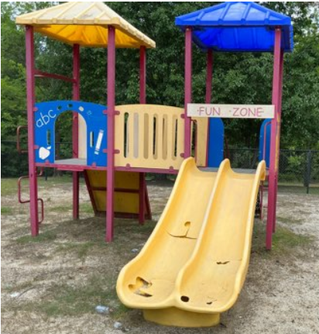
NSPIRE Standard - Example
Is this a NSPIRE Deficiency?
Yes
Damage created a Sharp Edge

Slide 43
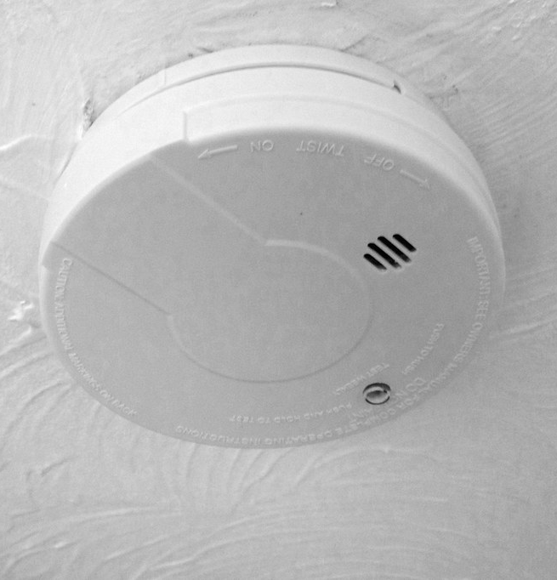
NSPIRE Standard - Example
DEFICIENCY 1 – UNIT: SMOKE ALARM IS NOT INSTALLED WHERE REQUIRED.
DEFICIENCY CRITERIA:
Smoke alarm is not installed inside each bedroom.
AND
Smoke alarm is not installed outside the bedroom(s).
AND
Smoke alarm is not installed on each level.
OBSERVATION:
- Observe each location where a smoke alarm is required.
- Verify a smoke alarm is present.
This Photo by Unknown Author is licensed under CC BY-SA-NC

Slide 44
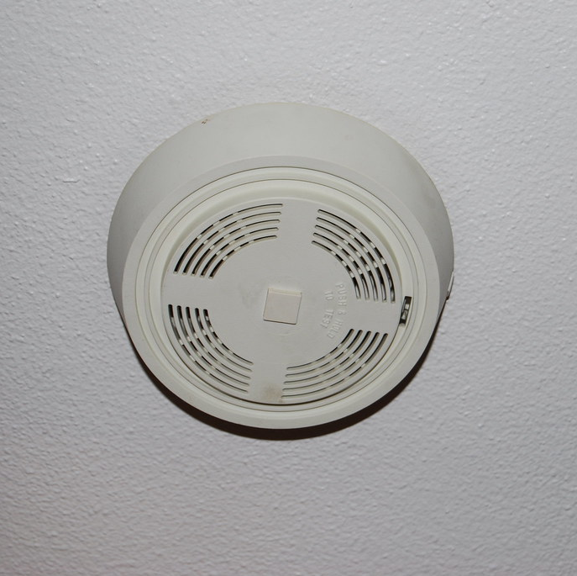
NSPIRE Standard - Example
More Information:
- A smoke alarm installed within a hallway in the immediate vicinity of multiple bedrooms meets the requirement of "outside the bedroom(s)" under this standard.
- A smoke alarm installed outside a bedroom may meet the requirement of "on each level" under this standard.
- If a smoke alarm is missing (i.e., evidence of prior installation, but is now not present or is incomplete) from a non-required area, then it should not be evaluated under this standard.
- If another hazard is present, then it should be evaluated under the respective standard (e.g., an exposed conductor should be evaluated under the Electrical – Conductor, Outlet, and Switch standard).
This Photo by Unknown Author is licensed under CC BY

Slide 45
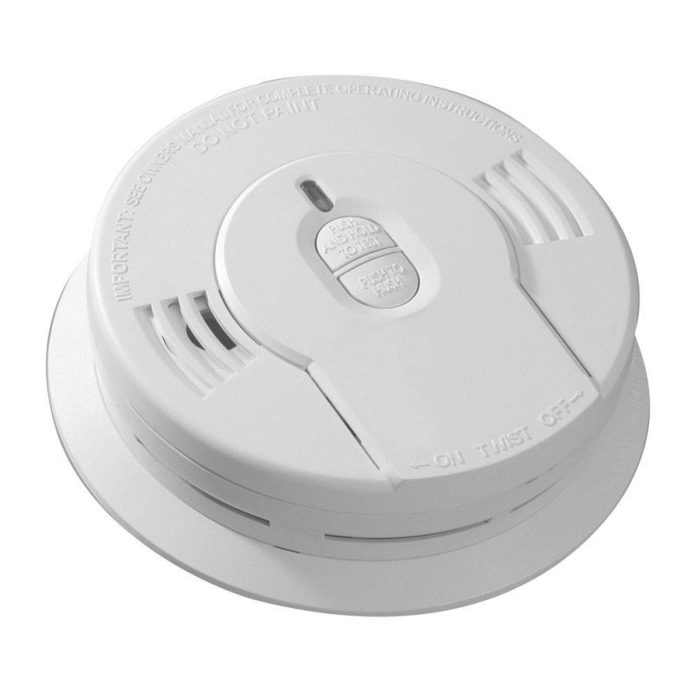
NSPIRE Standard - Example
DEFICIENCY 2 – UNIT: SMOKE ALARM IS OBSTRUCTED.
DEFICIENCY CRITERIA: Smoke alarm is obstructed.
ACTION:
- Determine if the smoke alarm is covered by a foreign object (e.g., plastic bag, shower cap, zip tie, paint, tape).
This Photo by Unknown Author is licensed under CC BY-NC-ND

Slide 46
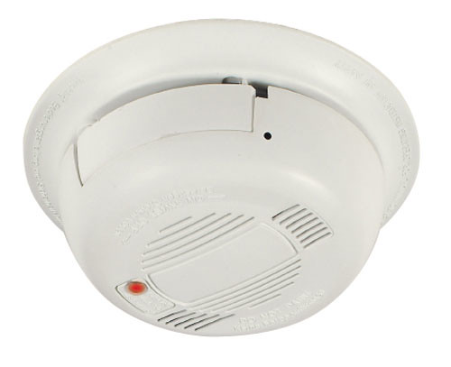
NSPIRE Standard - Example
DEFICIENCY 3 – UNIT: SMOKE ALARM DOES NOT PRODUCE AN AUDIO OR VISUAL ALARM WHEN TESTED.
DEFICIENCY CRITERIA: Smoke alarm does not produce an audio or visual alarm when tested.
ACTION:
- Press the test button and determine if the light on the smoke alarm flashes, strobes, or changes pattern in any way.
- Listen to hear if an alarm is emitted from the smoke alarm at an audible level to alert the resident.

Slide 47
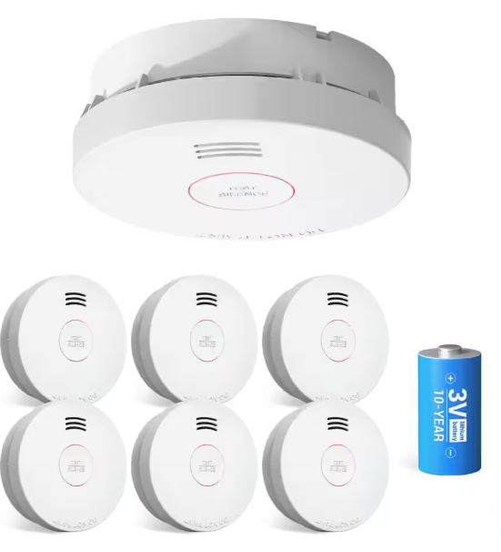
NSPIRE Standard - Example
By December 2024, Smoke Detectors must be hardwired or be a 10-Year Tamper Resistant Battery Smoke Detector.

Slide 48
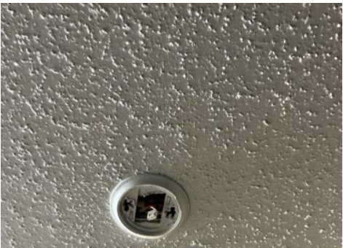
NSPIRE Standard - Example
Is this a NSPIRE Deficiency?
Yes
It is two NSPIRE Deficiencies.
Missing Smoke Detector and Exposed Wiring

Slide 49
NSPIRE Standard - Example
TITLE: CALL-FOR-AID SYSTEM
DEFICIENCY 1 – UNIT: SYSTEM IS BLOCKED, OR PULL CORD IS HIGHER THAN 6 INCHES OFF THE FLOOR.
DEFICIENCY CRITERIA: System is blocked.
OR
Pull cord end is higher than 6 inches off the floor.
OBSERVATION:
- Look for a call-for-aid system along the walls.
- Look to see if a cord is present if required; not all call-for-aid systems will have a cord, some may have a button.
- Look at the call-for-aid system and visually inspect for any obstruction that would prevent a resident from accessing the system (e.g., furniture and equipment, clothes, plants, etc.).

Slide 50
NSPIRE Standard - Example
ACTION:
- If a cord is present, measure the distance between the end of the pull cord and the floor to determine if it is greater than 6 inches
More Information:
- If the call-for-aid system is a button-only device, then do not record a deficiency for a pull cord end that is higher than 6 inches off the floor.

Slide 51
NSPIRE Standard - Example
DEFICIENCY 2 – UNIT: SYSTEM DOES NOT FUNCTION PROPERLY.
DEFICIENCY CRITERIA: A call-for-aid system does not emit sound or light or send a signal to the annunciator.
OR
The annunciator does not indicate the correct corresponding room.
OR
Pull cord is missing.
OR
Pull cord is tied up such that it cannot be engaged.

Slide 52
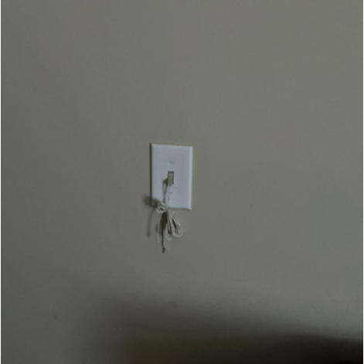
NSPIRE Standard - Example
Is this a NSPIRE Deficiency?
Yes

Slide 53
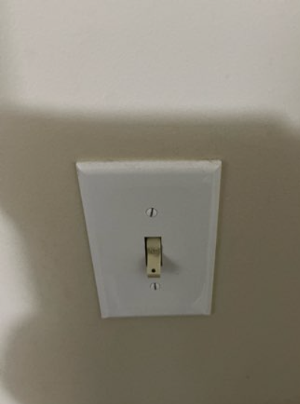
NSPIRE Standard - Example
Is this a NSPIRE Deficiency?
Yes

Slide 54
NSPIRE Standard - Example
TITLE: REFRIGERATOR
DEFICIENCY 1: Refrigerator is inoperable such that it may be unable to safely and adequately store food.
LOCATION: Unit/Inside
DEFICIENCY 2: Refrigerator component is damaged such that it impacts functionality.
LOCATION: Unit/Inside
DEFICIENCY 3: Refrigerator is missing.
LOCATION: Unit

Slide 55
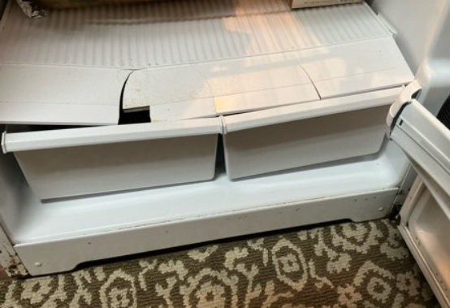
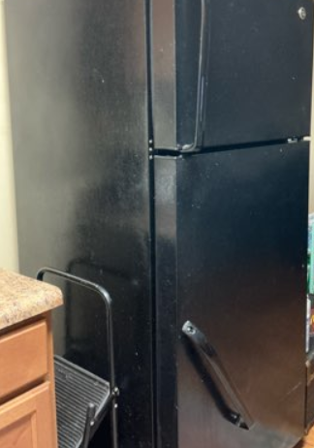
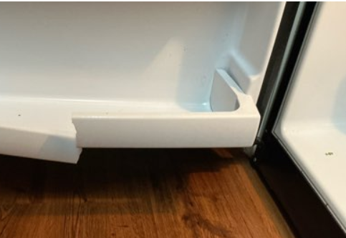
NSPIRE Standard - Example
Are these NSPIRE Deficiencies?
Yes

Slide 56
NSPIRE Standard - Example
Exposed Electrical Conductor (Unit, Inside, or Outside)
DEFICIENCY CRITERIA:
Electrical conductor is not enclosed or properly insulated (e.g., damaged or missing sheathing that exposes the insulated wiring or conductor, open port, missing knockout, missing outlet or switch cover, or missing breaker or fuse).
OR
An opening or gap is present and measures greater than ½ inch.
Example conductors to be evaluated under this deficiency include but are not limited to:
Knockouts
Device cover plates that are missing (i.e., evidence of prior installation, but now are not present or are incomplete)
Device cover plates that are damaged (i.e., visibly defective; impacts functionality)
Lighting fixtures
Visible wire nuts on electrical conductors
Wiring that is insulated but not protected by sheathing or conduit
Hardwire smoke alarm with an exposed conductor
Wall-mounted light fixture with a damaged or missing cover

Slide 57
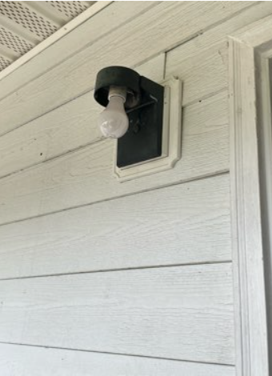
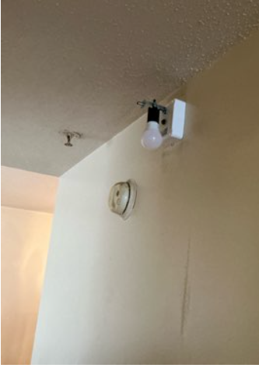
NSPIRE Standard - Example
Is this a NSPIRE Deficiency?
Yes

Slide 58
NSPIRE Standard - Example
DEFICIENCY 2 – UNIT: STORAGE COMPONENT IS DAMAGED, INOPERABLE, OR MISSING.
DEFICIENCY CRITERIA:
50% or more of the kitchen, bath, or laundry cabinet, drawers, or shelves are damaged (i.e., visibly defective; impacts functionality).
50% or more of the kitchen, bath, or laundry cabinet, drawers, or shelves are inoperable (i.e., overall system or component thereof is not meeting function or purpose; with or without visible damage).
50% or more of the kitchen, bath, or laundry cabinet, drawers, or shelves are missing (i.e., evidence of prior installation, but now not present or is incomplete).

Slide 59
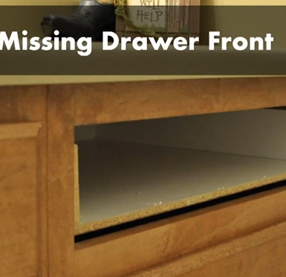
NSPIRE Standard - Example
Is this a NSPIRE Deficiency?
Location: Kitchen
Total Drawers in Kitchen: 6
No

Slide 60
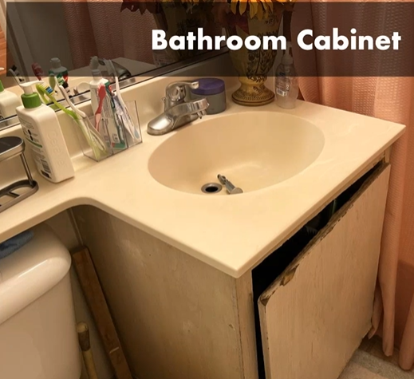
NSPIRE Standard - Example
Is this a NSPIRE Deficiency?
1 Cabinet Door in the Bathroom
Yes

Slide 61
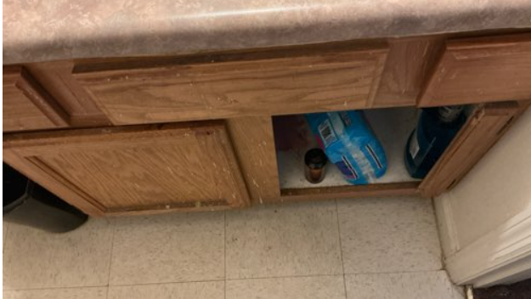
NSPIRE Standard - Example
Is this a NSPIRE Deficiency?
2 Cabinet Doors in Bathroom
3 Fake Drawer Covers in Bathroom
Yes

Slide 62
NSPIRE Standards
NSPIRE Standards will be updated at least once every three years.

