Slide 1
HOTMA

Slide 2


Slide 3

HOTMA
Everyone must use HOTMA on this date.
January 1, 2024
January 1, 2025
July 1, 2025
January 1, 2026

Slide 4

HOTMA
January 1, 2024
Once AHFA is ready, which we are, you can begin to use HOTMA

Slide 5

HOTMA
The following can be found on AHFA’s website:
HOTMA Certifications
Imputed Income Limitation
Passbook Savings Rate
Until January 1, 2026, you can use pre-HOTMA regulations.
However, you cannot use a combination of the two regulations.

Slide 6
HOTMA
What is different?
Annual Income
Nonrecurring Income
Income Hierarchy
Assets
Retirement Account
Exclusions for Net Family Assets and Income
Student Financial Assistance
Alimony & Child Support
Bank Statement
Number of Pay-Stubs
Passbook Rate

Slide 7
Exclusions from Net Family Assets
Exclusions can be found in the following:
AHFA Compliance Manual
IRS Notice H 2023-10
24 CFR Section 5.609(b)

Slide 8
Annual Income
Includes all amounts received from all sources by each member of the family who is 18 years of age or older, the head of household, or spouse of the head of household, in addition to unearned income received by or on behalf of each dependent who is under 18 years of age.
Annual income includes “all amounts received,” not the amount that a family may be legally entitled to receive but which they do not receive.

Slide 9
Nonrecurring Income
Income that will not be repeated beyond the coming year (i.e., the 12 months following the effective date of the certification), based on information provided by the family, is considered nonrecurring income and is excluded from annual income.
Income received as an independent contractor, day laborer, or seasonal worker is not excluded from income, even if the source, date, or amount of the income varies.
Income that has a discrete end date and will not be repeated beyond the coming year during will be excluded from a family’s annual income as nonrecurring income

Slide 10

Income Hierarchy
6, 5, 4, 3, 2, 1
Highest to Lowest

Slide 11

Income Hierarchy
#6
Enterprise Income Verification (EIV)
EIV is not allowed in the Housing Credit program

Slide 12

Income Hierarchy
#5
Upfront Income Verification (UIV) using non-EIV system.
Examples:
Web-Based State Benefit Systems
The Work Number
truv – Income/Assets (Gig Economy)
Finicity – Asset Verification
Experian – Income/Asset Verification
Plaid – Income/Asset Verification
Argyle – Income/Asset Verification

Slide 13

Income Hierarchy
#4
Written, 3rd Party Verification
“Tenant-Provided Verification“
Example:
Self-Employment
Go Fund Me Account
Veterans Benefits
Pay Stubs
Letter of Hire
SSA Benefit Letter
Bank Statements

Slide 14
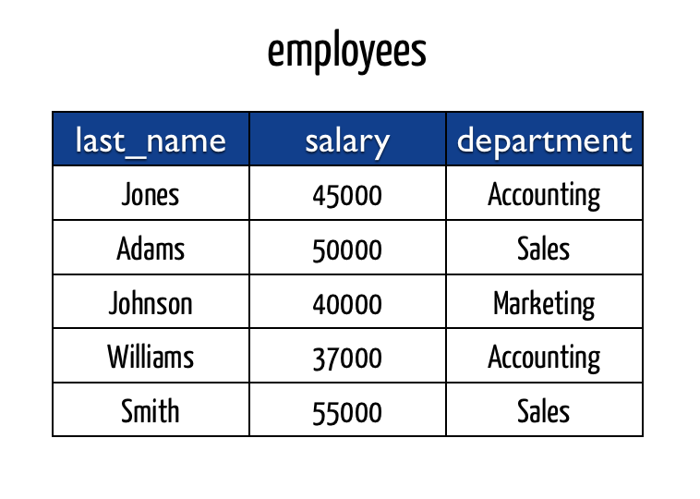
Income Hierarchy
#3
Written, 3rd Party Verification Form
“Traditional 3rd Party Verification”
A form completed by the 3rd party by hand. (in writing or type-set)

Slide 15

Income Hierarchy
#2
Oral 3rd Party Verification
Contacting the Income Source via telephone or in-person
This type must be documented in the file with the following:
Date and Time of the call or visit
Name of Contact Person and their telephone #
Confirmed Information

Slide 16

Income Hierarchy
#1
Self-Certification (not a 3rd party verification)
Use as a last resort when unable to obtain any type of 3rd party verification
Must Document the File with the following:
Why 3rd party verification was not available
Not required to be notarized, but it is recommended to use language to ensure the individual knows the consequences of knowingly providing false information

Slide 17
Assets
Net family assets are defined as the net cash value of all assets owned by the family, after deducting reasonable costs that would be incurred in disposing of real property, savings, stocks, bonds, and other forms of investment, except as excluded.
Determining Net Family Assets
Notice H 2023-10, page 44-46
Exclusions from Net Family Assets
AHFA Compliance Manual
Notice H 2023-10, page 46-47
Necessary and Non-Necessary Personal Property
Notice H 2023-10, page 47-48

Slide 18
Necessary and Non-Necessary Personal Property (NNPP)
Necessary personal property is excluded from net family assets.
Non-necessary personal property with a combined value greater than the Imputed Income Limitation (currently $51,600) is considered part of net family assets.

Slide 19
Necessary and Non-Necessary Personal Property (NNPP)
All Assets are categorized as either:
Real Property
Land
Home
Personal Property
Boats
Bank Account(s)

Slide 20
Necessary and Non-Necessary Personal Property (NNPP)
Necessary Personal Property
Items that are essential to the family for the following:
Maintenance, Use, and Occupancy of the Premises as a Home
Necessary for Employment
Necessary for Education
Necessary for Health and Wellness
Do not include bank accounts, other financial investments, or luxury items

Slide 21
Necessary and Non-Necessary Personal Property (NNPP)
Examples of each list can be found:
Notice H 2023-10, page 48 (this is not an exhaustive list).

Slide 22
Retirement Accounts
Most retirement accounts such as:
IRA
Employer Retirement Plan
Retirement Plan for a Self-Employed Individual(s)
Do not count when calculating Assets.
You do count if the applicant/resident is receiving distributions, but this amount would be a part of the Gross Income.

Slide 23
Student Financial Assistance Non-Section 8
All assistance received under 479B of the HEA by students participating in the Public Housing or non–Section 8 programs is excluded from income.
Other student financial assistance received by the student that, either by itself or in combination with HEA assistance, exceeds the actual covered costs is not excluded from income.

Slide 24
Student Financial Assistance
What are Covered Costs?
Tuition
Books
Supplies
Room and Board
Fees charged to a Student by an Institution of Higher Learning

Slide 25

Student Financial Assistance Non-Section 8
Steps in Calculating Amount of Other Student Financial Assistance
Step 1: Subtract the amount received under section 479B of the HEA from the actual covered costs to arrive at the amount of actual covered costs exceeding section 479B assistance.
Step 2: Subtract the actual covered costs exceeding section 479B assistance from the amount of other student financial assistance to arrive at the amount of student financial assistance included in income.

Slide 26
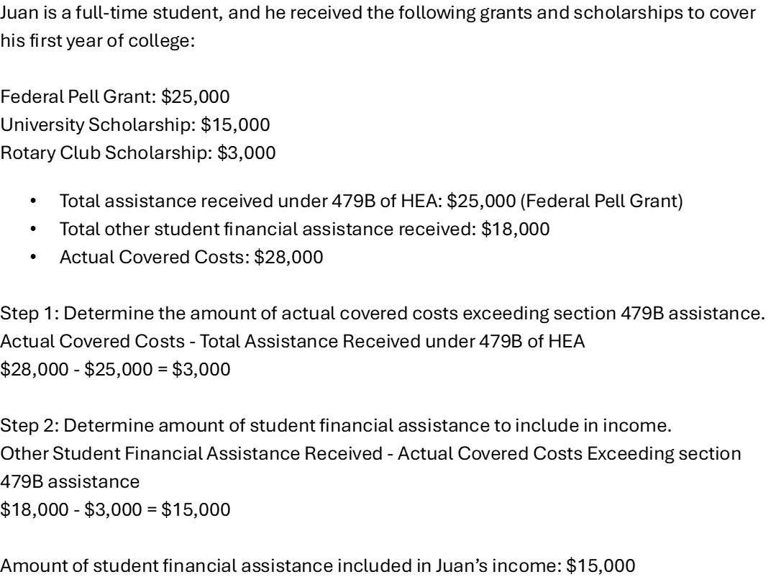
Student Financial Assistance Non-Section 8

Slide 27
Student Assistance Section 8
If the student is the head of household, co-head, or spouse and is under the age of 23 or without dependent children, then both the assistance received under 479B of the HEA and other student financial assistance received by the student will be counted as income to the extent that it exceeds the total of tuition and any other required fees and charges.
In contrast, the student financial assistance received by a Section 8 student who is the head of household, spouse, or co-head of household and is over the age of 23 with dependent children will be treated in a manner identical to the student financial aid received by students who participate in non–Section 8 programs

Slide 28
Student Assistance Section 8
There are two steps required as part of the calculation for Section 8 students:
Step 1 - Determine the student’s relationship to the household, age, and whether they have dependent children
Step 2 - Based on the result of the first step; calculate whether any excess student financial assistance should be included in the family’s income.
If the student is the head of household, co-head, or spouse and is 23 or younger or does not have dependent children, then 479B assistance will be part of the total equation.
If the student is over 23 with dependent children, then the calculation will be identical for non–Section 8 students

Slide 29
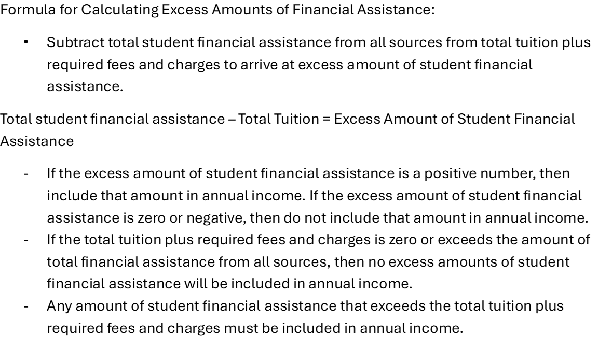
Student Assistance Section 8

Slide 30
Student Assistance Section 8

Slide 31
Alimony & Child Support
Annual income includes “all amounts received,” not the amount that a family may be legally entitled to receive but which they do not receive.
For example, a family’s child-support or alimony income must be based on payments received, not the amounts to which the family is entitled by court or agency orders.

Slide 32
Bank Statement
Owners are required to obtain a minimum of two current and consecutive pay stubs for determining annual income from wages

Slide 33
Pay-Stubs
Owners are required to obtain a minimum of two current and consecutive pay stubs for determining annual income from wages

Slide 34
Passbook Rate
HUD will annually publish the passbook rate and Imputed Income Limitation.
AHFA will post the HUD Passbook Rate & Imputed Income Limitation in the Compliance - Addendums, Certifications & Verifications section on the AHFA website.
For 2025:
The HUD Passbook Rate is 0.45%
The Imputed Income Limitation is $51,600

