Slide 1
NSPIRE

Slide 2
NSPIRE
What is NSPIRE?
  National Standards for the Physical Inspection of Real Estate
When did inspections change to NSPIRE?
  Final Rule May 11, 2023
  AHFA October 1, 2023

Slide 3
NSPIRE
NSPIRE has Three (3) Inspectable Areas:
  Unit
  Inside
  Outside

Slide 4
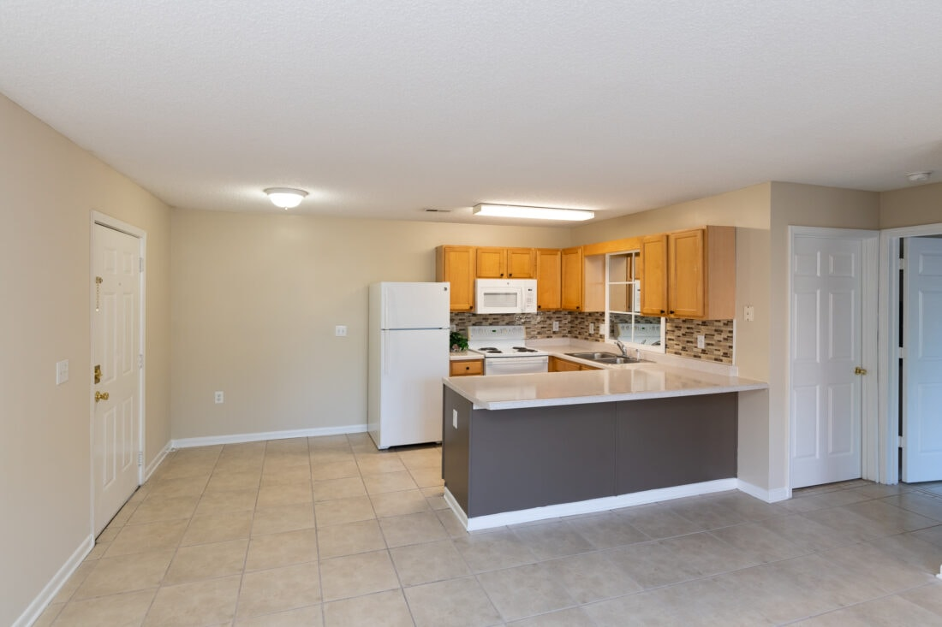
NSPIRE
Unit
A “Unit” of HUD housing refers to the interior components of an individual dwelling, where the resident lives.
This Photo by Unknown Author is licensed under CC BY-NC-ND

Slide 5
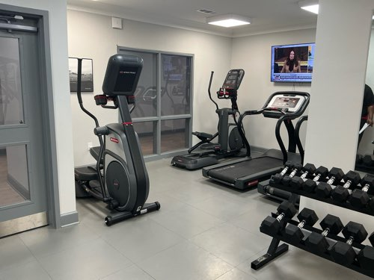
NSPIRE
INSIDE
“Inside” refers to the common areas and building systems within the building interior and are not inside a unit. This could include interior laundry facilities, workout rooms, and so on.

Slide 6
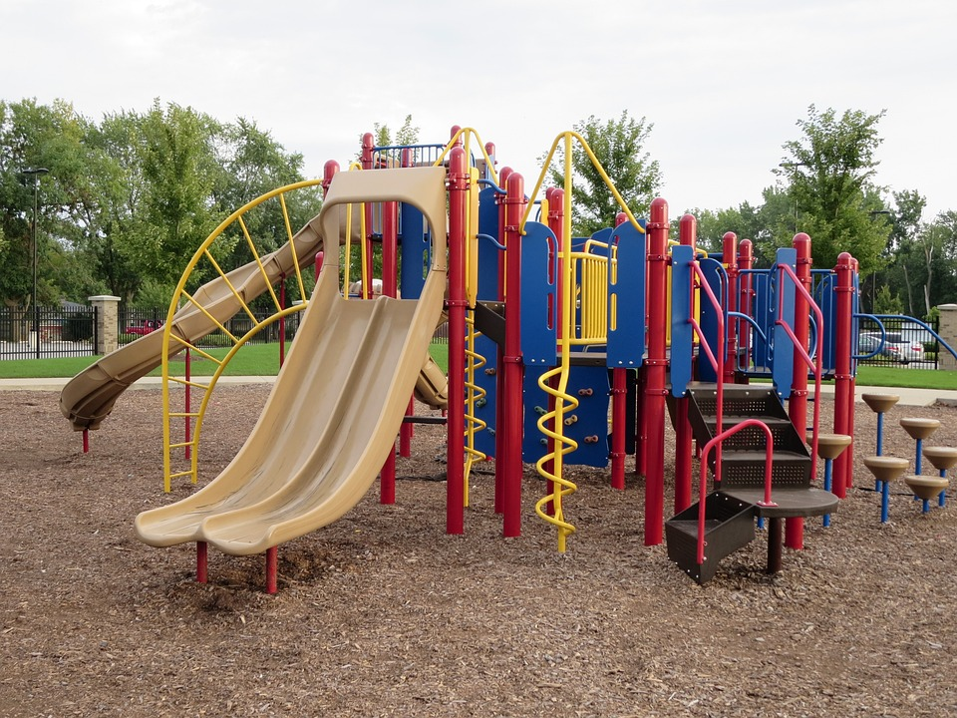
NSPIRE
OUTSIDE
“Outside” refers to the building site, building exterior components, and any building systems located outside of the building or unit. This includes things like playgrounds, sidewalks, and air-conditioning units.

Slide 7

Inspection Day Preparations
Inspections are taking longer.
  Average 56-unit property
  12 units are inspected
  In the past, this would take AHFA about 1-hour
  Now, it takes 2-hours (sometimes longer)

Slide 8
NSPIRE Requirement for AHFA Properties
Management Must Participate in the inspection
It is very important to have Maintenance present or at least in the area so that any 24-hour correction can be made
Make sure your Maintenance is familiar with the NSPIRE Standards

Slide 9
NSPIRE Standards
The standards can be found by searching the HUD website or using the following link:
https://www.hud.gov/reac/nspire-standards

Slide 10
NSPIRE Facts
Correction Timeframe is based on the finding.
24-Hours
30-Days
60-Days

Slide 11
NSPIRE Standards
NSPIRE Standards will be updated at least once every three years.

Slide 12
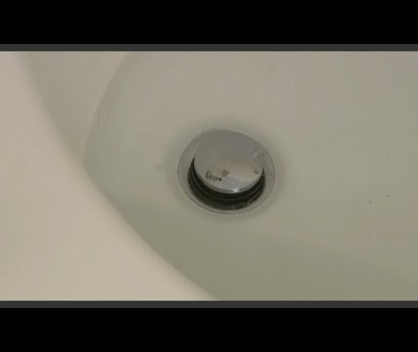
Bathtub Won’t Drain

Slide 13
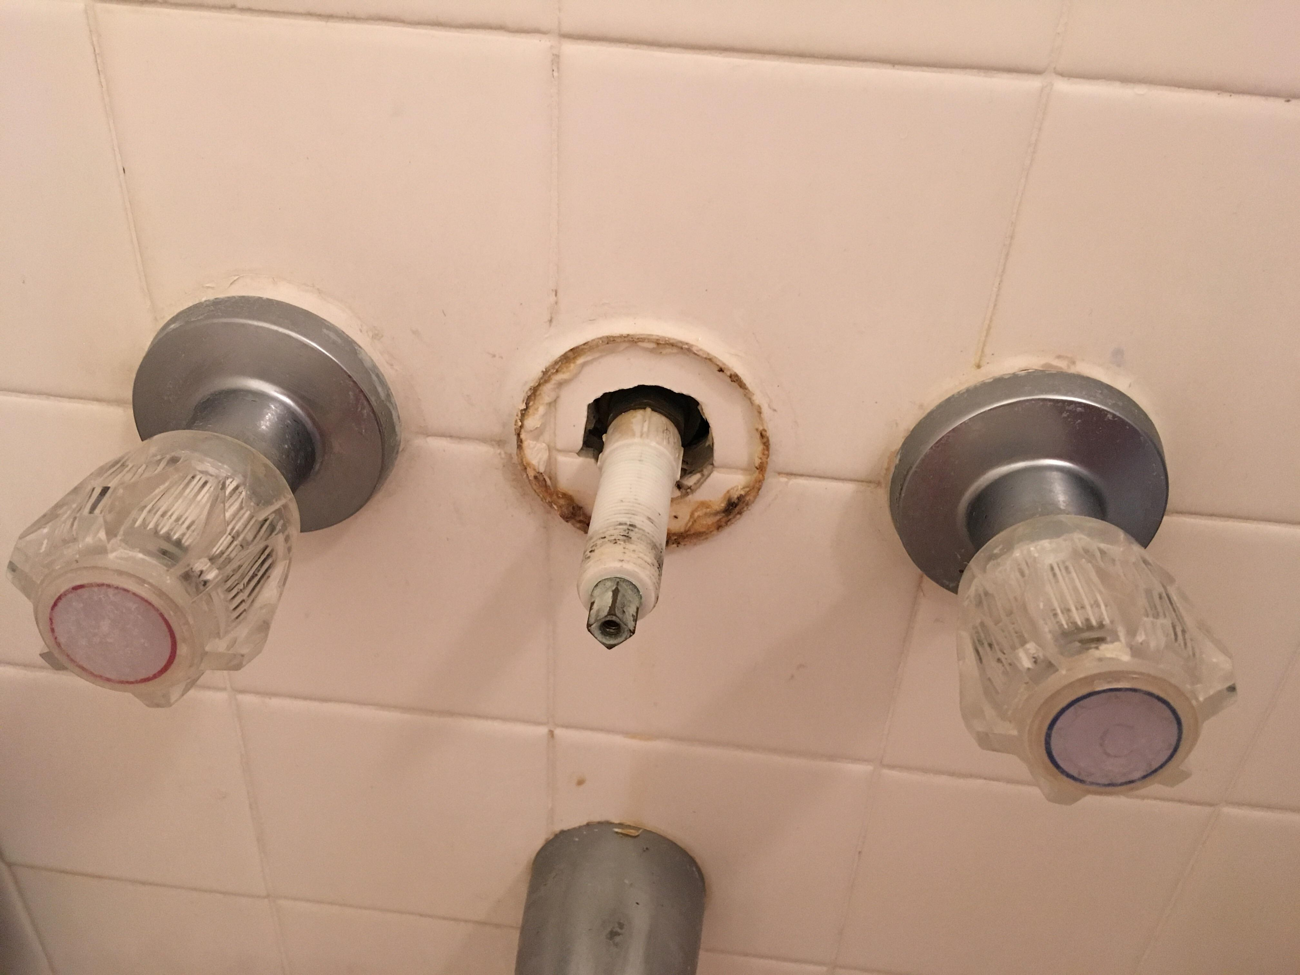
Bathtub or Shower Component

Slide 14
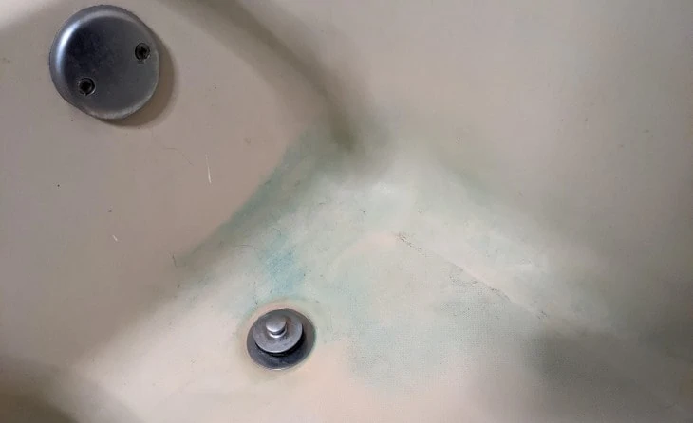
Bathtub Discoloration

Slide 15
NSPIRE Facts
Different areas of the unit are being inspected. Here are a few, but this is NOT the complete list:
  Windows
  Stove
    Oven
    Eyes
  All Electric Outlets
  All GFCI Outlets
  Bathroom Sink(s)
  Bathroom Shower/Tub
  Water Heater
  Balcony
  Fire Extinguisher
  Cabinets and Drawers

Slide 16
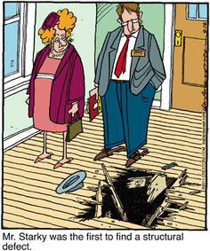
A Few of the Common Unit Issues
Windows
Window Screen
Sinks
Designated Outlets
Fire Extinguishers
Water Heaters
Smoke detectors
Emergency Pull Cords/Call Buttons

Slide 17
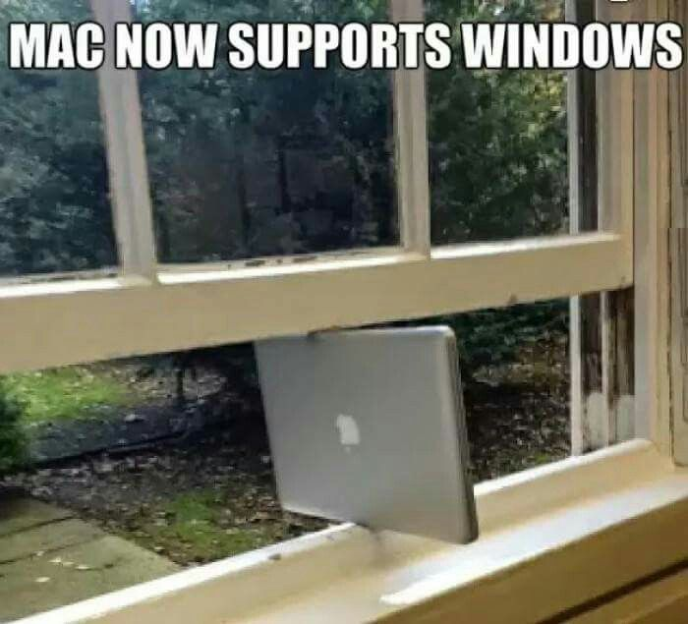
NSPIRE Standards - Example
Window Standard
DEFICIENCY CRITERIA:
Window will not open.
OR
Once opened, window will not stay open without the use of a tool or item.

Slide 18
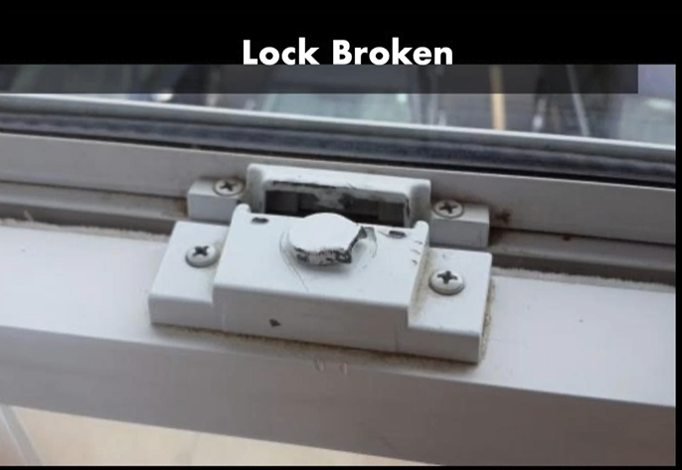

Slide 19
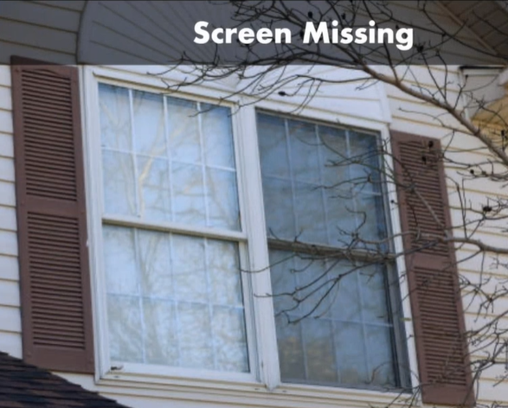
NSPIRE Standards - Example
Are Missing Window Screens a NSPIRE Deficiency?
Yes
If there is evidence that the window should have a screen

Slide 20

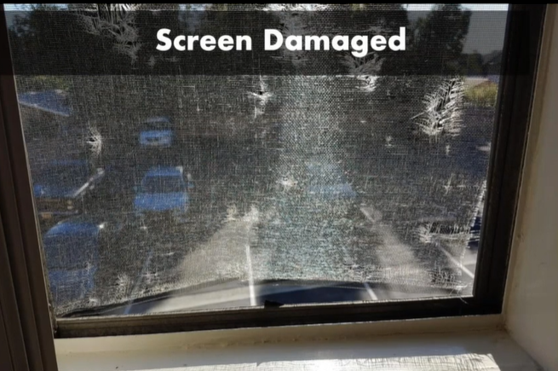
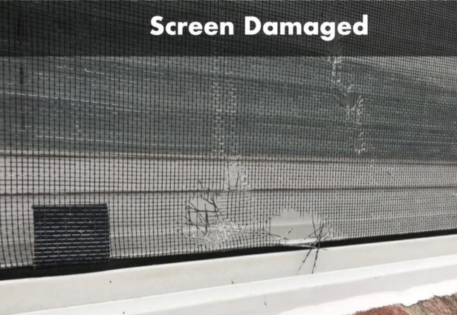
NSPIRE Standards - Example
Are Damaged Window Screens a NSPIRE Deficiency?
Yes
Damage must be greater than 1 in.

Slide 21
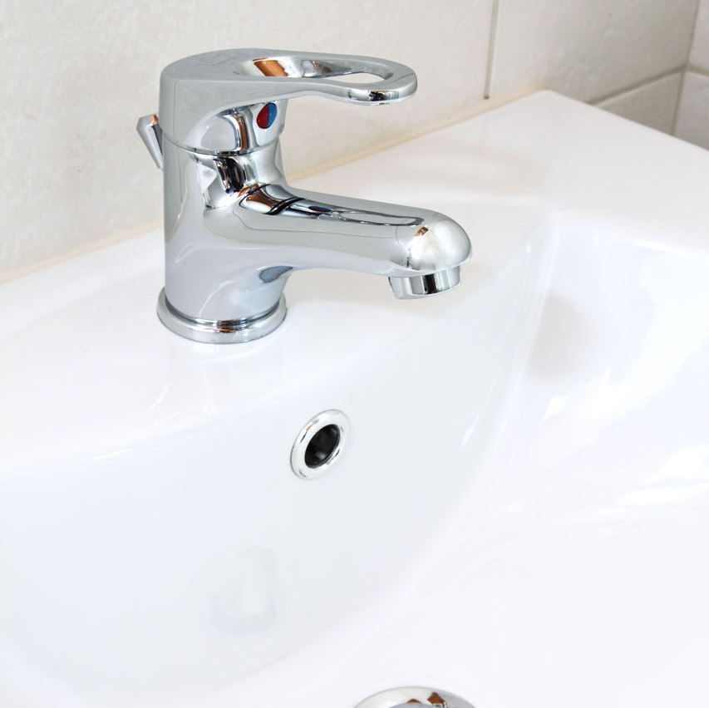
NSPIRE Standards - Example
Sink Standard
A basin with hardware designed to dispense and hold clean water (hot and cold) and discharge wastewater.

Slide 22
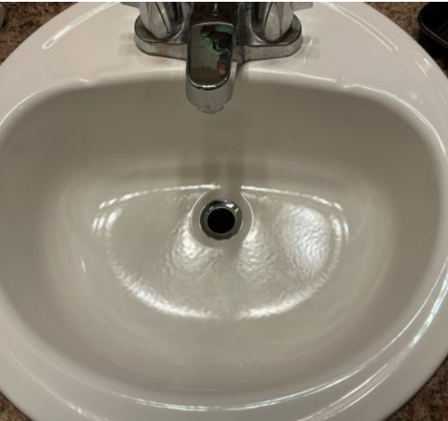
NSPIRE Standards - Example
Is this a NSPIRE Deficiency?
Yes

Slide 23
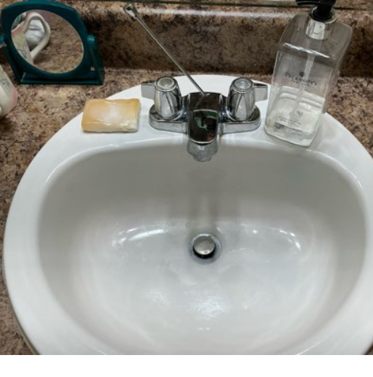
NSPIRE Standards - Example
Is this a NSPIRE Deficiency?
Yes

Slide 24
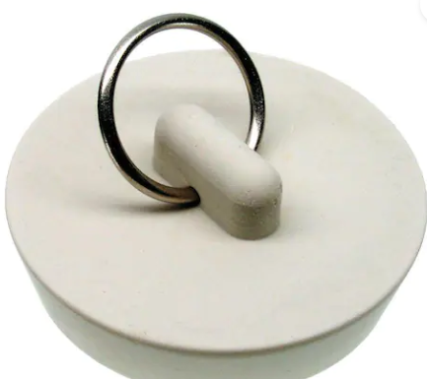
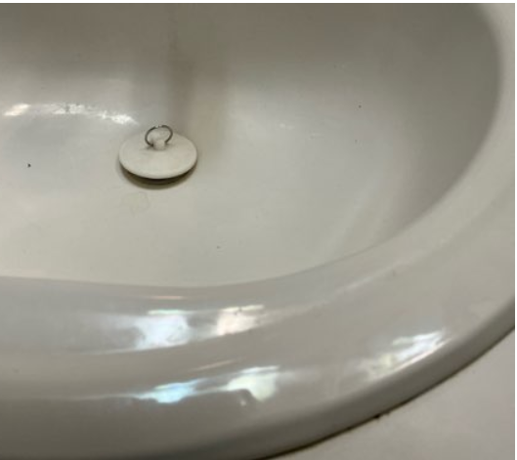
NSPIRE Standards - Example
Is this a NSPIRE Deficiency if used in a sink?
No
However, it must allow the sink basin to retain water. It must fit the size of the drain.

Slide 25
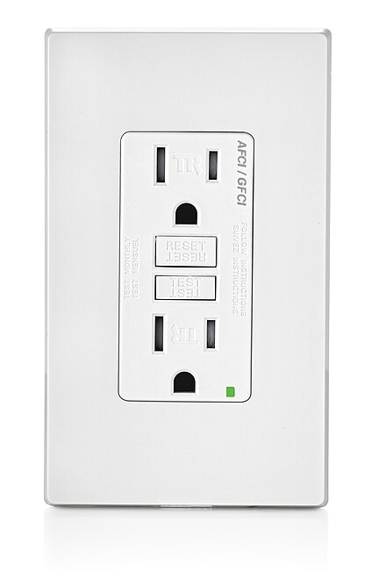
NSPIRE Standard - Example
DEFICIENCY 1 – GFCI OUTLET OR GFCI BREAKER IS NOT VISIBLY DAMAGED AND THE TEST OR RESET BUTTON IS INOPERABLE.DEFICIENCY CRITERIA:
GFCI outlet or GFCI breaker does not have visible damage and the test or reset button is inoperable (i.e., overall system or component thereof is not meeting function or purpose).
OBSERVATION:
Identify all GFCI outlets and GFCI breakers.
Action:
Engage the test button on each GFCI outlet and GFCI breaker.
After engaging the test button, determine if the GFCI outlet or GFCI breaker trips.
Then, engage the reset button.
This Photo by Unknown Author is licensed under CC BY-SA

Slide 26
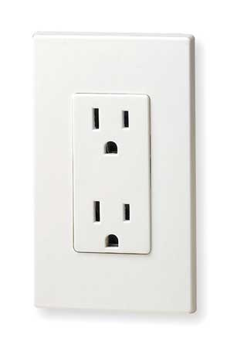
NSPIRE Standards - Example
DEFICIENCY 3 – UNIT: AN UNPROTECTED OUTLET IS PRESENT WITHIN SIX FEET OF A WATER SOURCE
Outlet is present within six feet of a water source (i.e., sink, bathtub, shower, water faucet, toilet) that is located in the same room.
AND
Outlet is not GFCI protected.
This Photo by Unknown Author is licensed under CC BY-SA

Slide 27
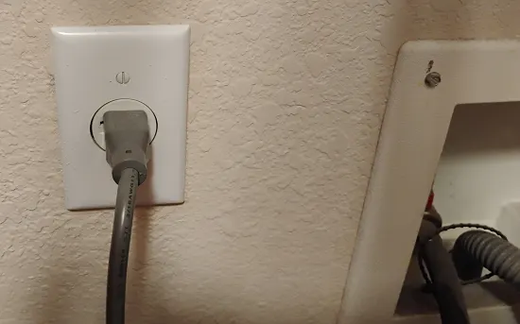
NSPIRE Standard - Example
MORE INFORMATION:
- An outlet dedicated to a major appliance (e.g., water heater, HVAC, refrigerator, washing machine, dishwasher, garbage disposal, appliance that is wall-mounted or installed within a cabinet, etc.) should NOT be evaluated under this standard, regardless of its distance from the water source.
- A dedicated outlet is a receptacle outlet that is only capable of serving that specific appliance.

Slide 28
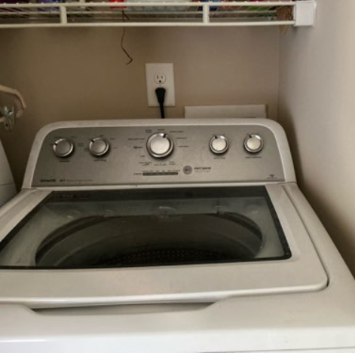
NSPIRE Standard - Example
Is this a NSPIRE Deficiency?
Yes
If the outlet is not dedicated or GFCI protected.

Slide 29
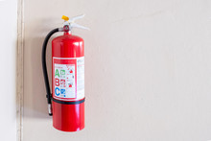
NSPIRE Standard - Examples
Deficiency Criteria:
Pressure gauge indicates that the fire extinguisher is over or under-charged.
The date on the service tag of any fire extinguisher has exceeded one year.
or
The fire extinguisher tag is missing or illegible.
or
A nonchargeable or disposable fire extinguisher is more than 12 years old (based on manufacture date).
Fire extinguisher is damaged (i.e., visibly defective; impacts functionality).
or
Fire extinguisher is missing (i.e., evidence of prior installation, but now not present or is incomplete).

Slide 30
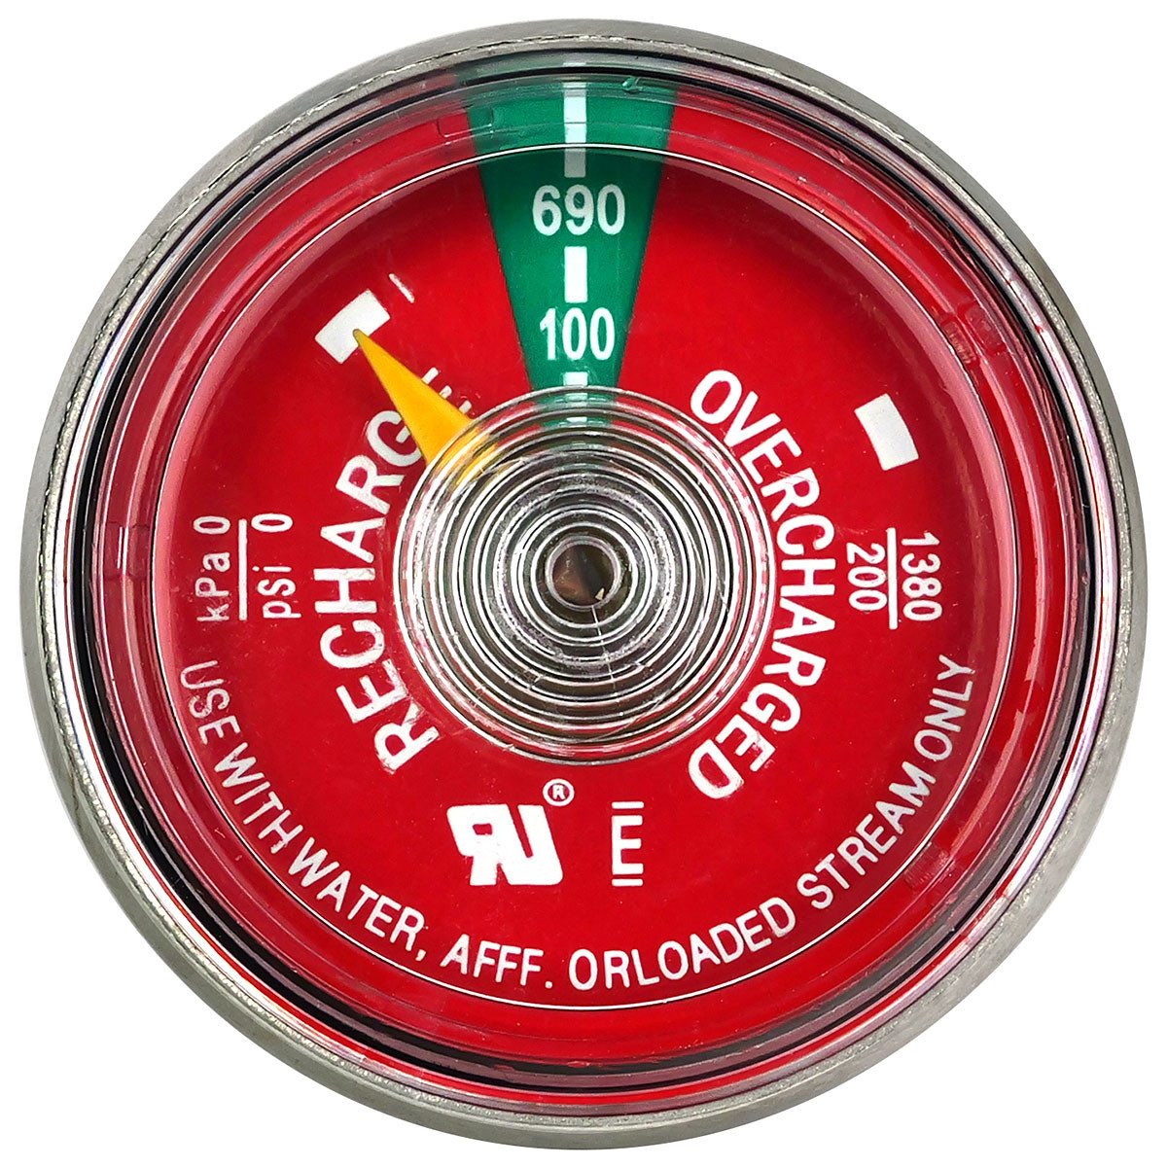
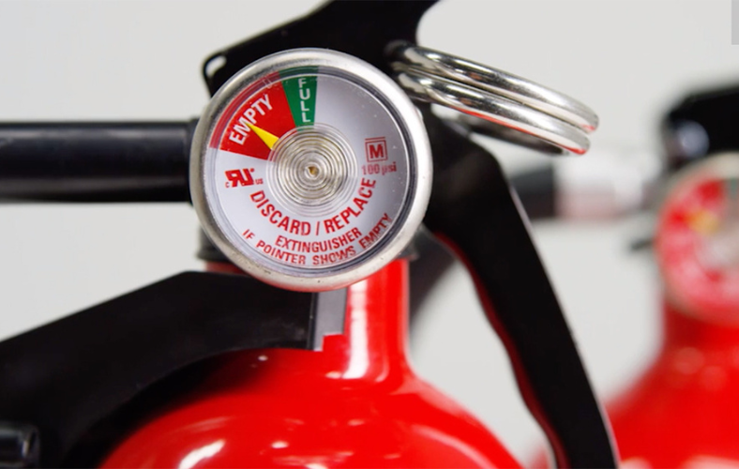
Different Types of Fire Extinguishers

Slide 31
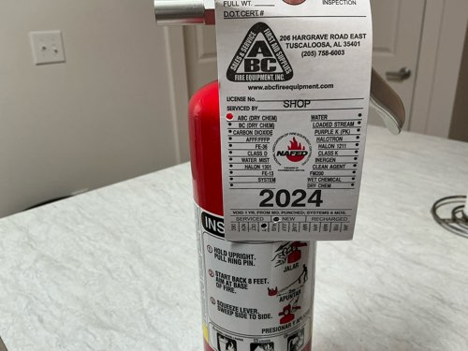
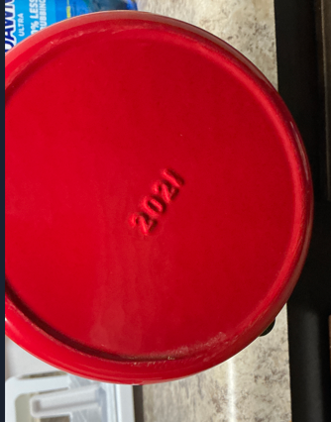
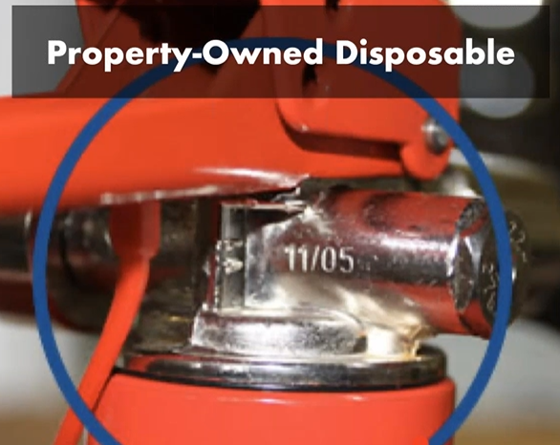
Legible Service Tag and Date Stamp

Slide 32
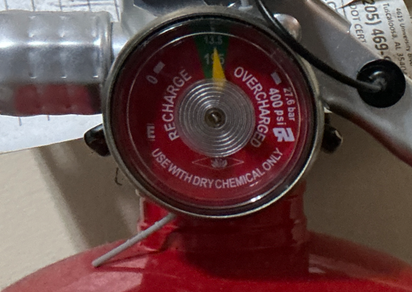
NSPIRE Standard - Examples
Does this Fire Extinguisher require an annual inspection?
Yes

Slide 33
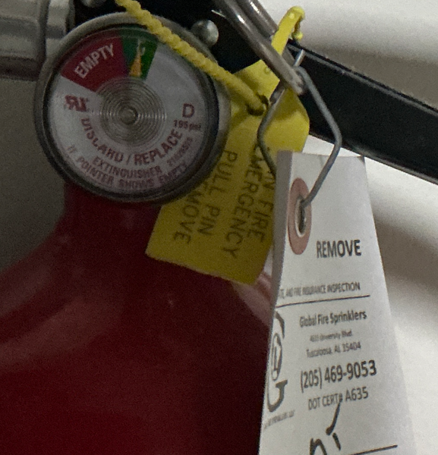
NSPIRE Standard - Examples
Does this Fire Extinguisher require an annual inspection?
No
It is good for 12-years based on the manufacturing date that will either be on the neck or bottom of the fire extinguisher

Slide 34
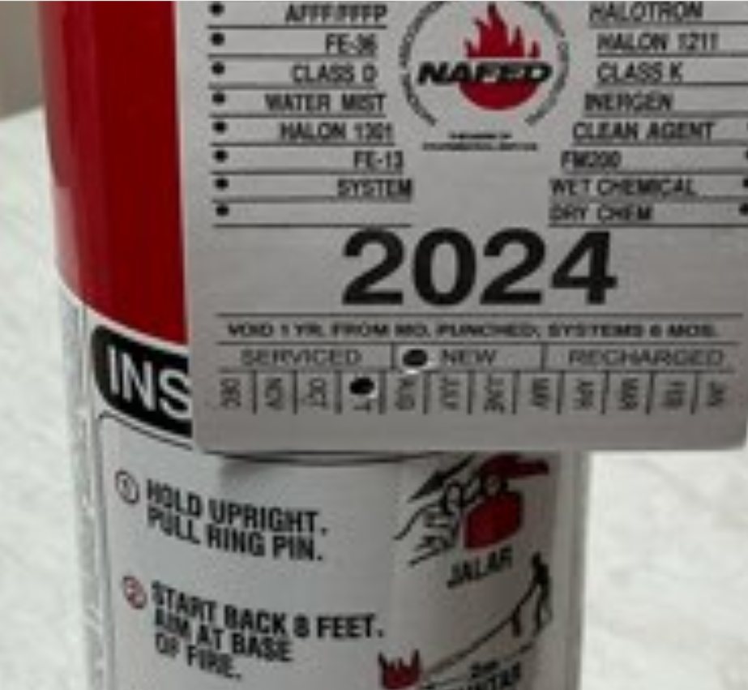
NSPIRE Standard - Examples
Is this a NSPIRE Deficiency if the inspection was performed in October 2025?
Yes

Slide 35
NSPIRE Standard - Examples
Is this a NSPIRE Deficiency if the inspection was performed May 22, 2025?
Yes

Slide 36
NSPIRE Standard - Examples
Is this a NSPIRE Deficiency if the inspection was performed May 22, 2025?
No

Slide 37
NSPIRE Standard - Examples
Water Heater
DEFICIENCY 1 – UNIT:
TEMPERATURE PRESSURE RELIEF (TPR) VALVE HAS AN ACTIVE LEAK OR IS OBSTRUCTED OR RELIEF VALVE DISCHARGE PIPING IS DAMAGED, CAPPED, HAS AN UPWARD SLOPE, OR IS CONSTRUCTED OF UNSUITABLE MATERIAL.
DEFICIENCY CRITERIA:
TPR valve has an active leak.
TPR valve is obstructed such that the TPR valve is unable to be fully actuated.
Relief valve discharge piping is damaged (i.e., visibly defective; impacts functionality), capped, has an upward slope, or is constructed of unsuitable material.

Slide 38
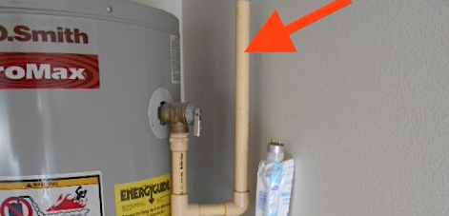
Discharge Pipe Has Upward Slope

Slide 39
NSPIRE Standard - Examples
DEFICIENCY 3 – THE RELIEF VALVE DISCHARGE PIPING IS MISSING OR TERMINATES GREATER THAN 6 INCHES OR LESS THAN 2 INCHES FROM WASTE RECEPTOR FLOOD-LEVEL.
DEFICIENCY CRITERIA:
The relief valve discharge piping is missing (i.e., evidence of prior installation, but is now not present or is incomplete).
The relief valve discharge piping terminates greater than 6 inches or less than 2 inches from waste receptor flood-level.

Slide 40
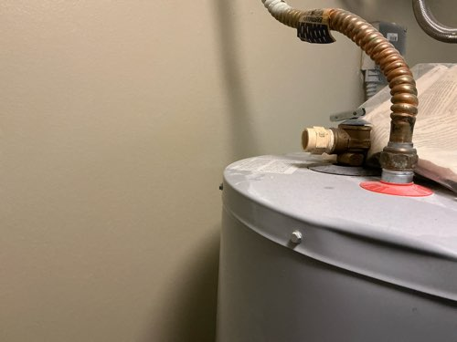
NSPIRE Standard - Example
Is this a NSPIRE Deficiency?
Yes
The Relief Valve Discharge Piping is missing.

Slide 41
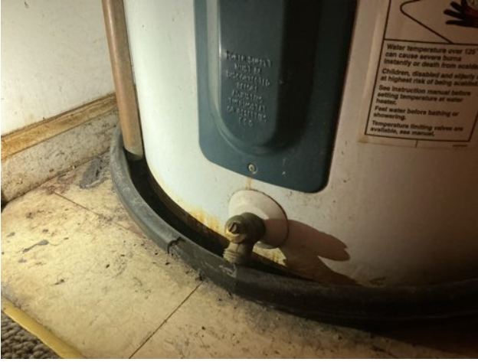
NSPIRE Standard - Example
Is this a NSPIRE Deficiency?
Yes
The Relief Valve Discharge Piping terminates greater than 6 in. or less than 2 in. from Waste Receptor Flood-Level.

Slide 42
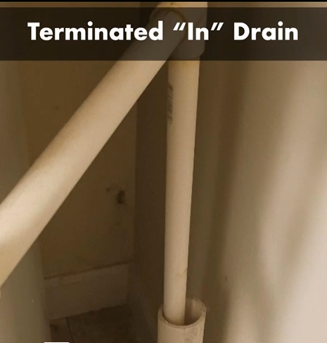
NSPIRE Standard - Example
Is this a NSPIRE Deficiency?
Yes
The Relief Valve Discharge Piping is less than 2 in. from Waste Receptor Flood-Level.

Slide 43
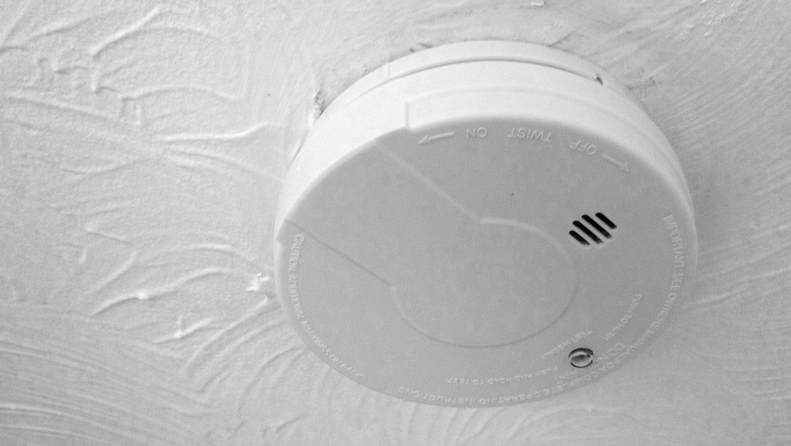
NSPIRE Standard - Example
DEFICIENCY 1 – UNIT: SMOKE ALARM IS NOT INSTALLED WHERE REQUIRED.
DEFICIENCY CRITERIA:
Smoke alarm is not installed inside each bedroom.
AND
Smoke alarm is not installed outside the bedroom(s).
AND
Smoke alarm is not installed on each level.
OBSERVATION:
- Observe each location where a smoke alarm is required.
- Verify a smoke alarm is present.
This Photo by Unknown Author is licensed under CC BY-SA-NC

Slide 44
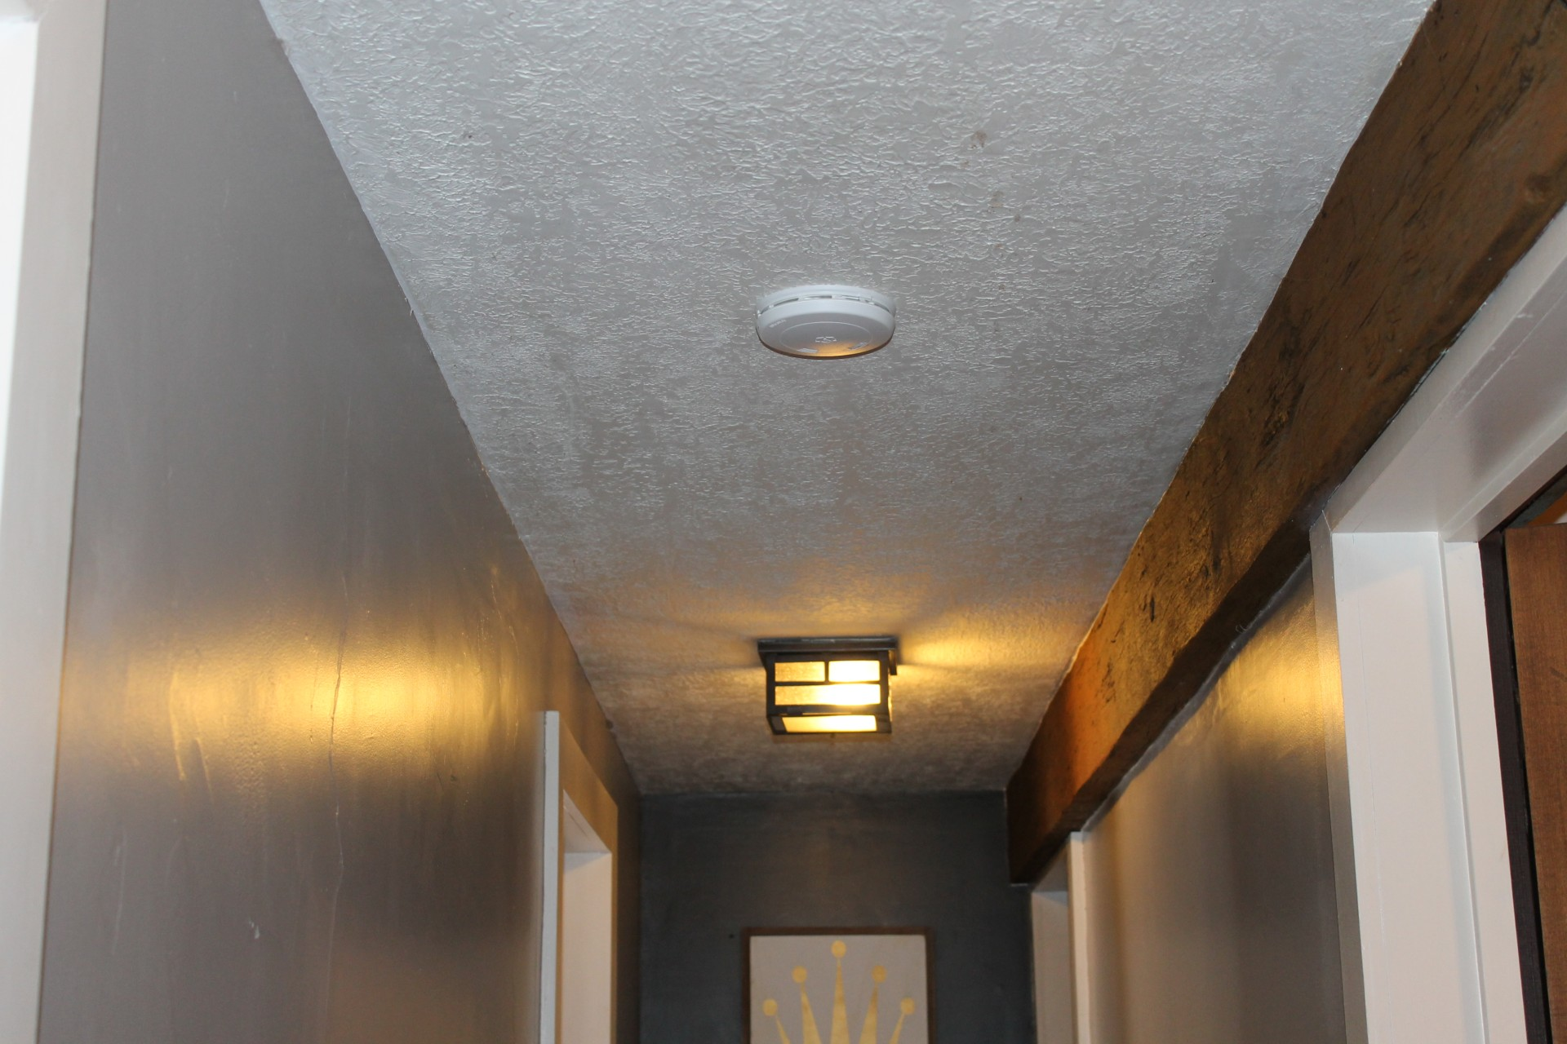
NSPIRE Standard - Example
More Information:
- A smoke alarm installed within a hallway in the immediate vicinity of multiple bedrooms meets the requirement of "outside the bedroom(s)" under this standard.
- A smoke alarm installed outside a bedroom may meet the requirement of "on each level" under this standard.
- If a smoke alarm is missing (i.e., evidence of prior installation, but is now not present or is incomplete) from a non-required area, then it should not be evaluated under this standard.
- If another hazard is present, then it should be evaluated under the respective standard (e.g., an exposed conductor should be evaluated under the Electrical – Conductor, Outlet, and Switch standard).

Slide 45
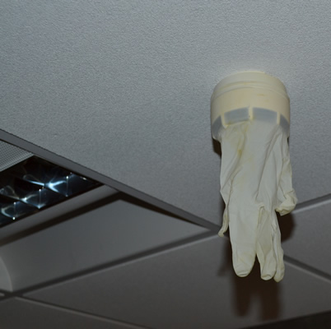
NSPIRE Standard - Example
DEFICIENCY 2 – UNIT: SMOKE ALARM IS OBSTRUCTED.
DEFICIENCY CRITERIA: Smoke alarm is obstructed.
ACTION:
- Determine if the smoke alarm is covered by a foreign object (e.g., plastic bag, shower cap, zip tie, paint, tape).

Slide 46
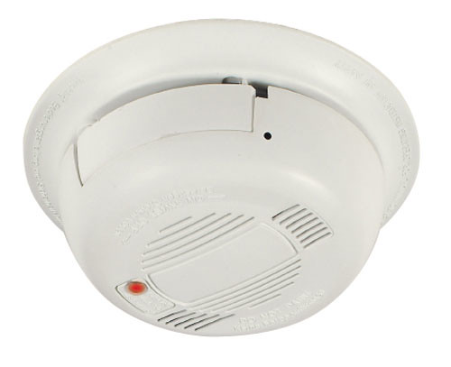
NSPIRE Standard - Example
DEFICIENCY 3 – UNIT: SMOKE ALARM DOES NOT PRODUCE AN AUDIO OR VISUAL ALARM WHEN TESTED.
DEFICIENCY CRITERIA: Smoke alarm does not produce an audio or visual alarm when tested.
ACTION:
- Press the test button and determine if the light on the smoke alarm flashes, strobes, or changes pattern in any way.
- Listen to hear if an alarm is emitted from the smoke alarm at an audible level to alert the resident.

Slide 47
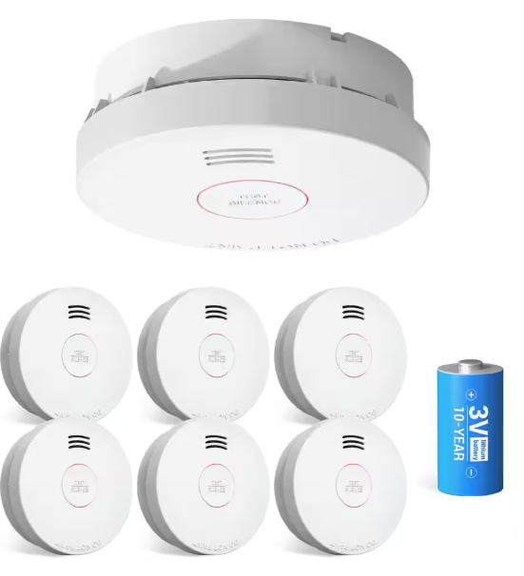
NSPIRE Standard - Example
By December 2024, Smoke Detectors must be hardwired or be a 10-Year Tamper Resistant Battery Smoke Detector.

Slide 48
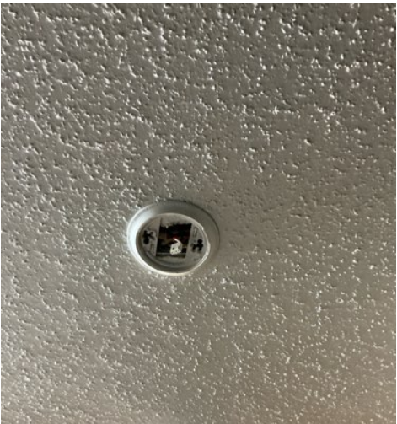
NSPIRE Standard - Example
Is this a NSPIRE Deficiency?
Yes
It is two NSPIRE Deficiencies.
Missing Smoke Detector and Exposed Wiring

Slide 49
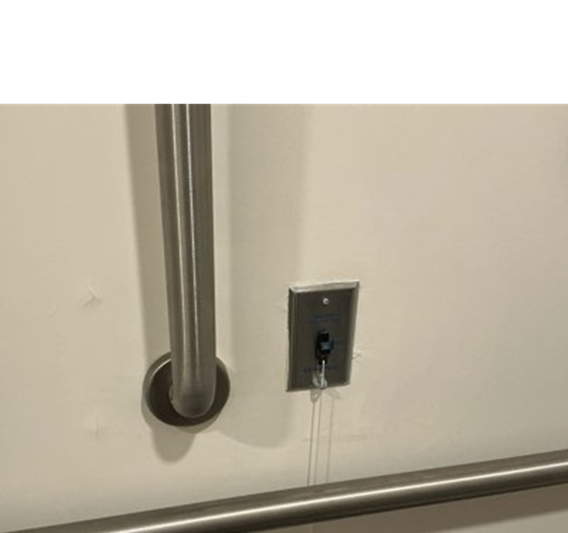
Call-For-Aid System

Slide 50
NSPIRE Standard - Example
TITLE: CALL-FOR-AID SYSTEM
DEFICIENCY 1 – UNIT: SYSTEM IS BLOCKED OR PULL CORD IS HIGHER THAN 6 INCHES OFF THE FLOOR.
DEFICIENCY CRITERIA: System is blocked.
OR
Pull cord end is higher than 6 inches off the floor.
OBSERVATION:
- Look for a call-for-aid system along the walls.
- Look to see if a cord is present if required; not all call-for-aid systems will have a cord, some may have a button.
- Look at the call-for-aid system and visually inspect for any obstruction that would prevent a resident from accessing the system (e.g., furniture and equipment, clothes, plants, etc.).

Slide 51
NSPIRE Standard - Example
DEFICIENCY 2 – UNIT: SYSTEM DOES NOT FUNCTION PROPERLY.
DEFICIENCY CRITERIA: A call-for-aid system does not emit sound or light or send a signal to the annunciator.
OR
The annunciator does not indicate the correct corresponding room.
OR
Pull cord is missing.
OR
Pull cord is tied up such that it cannot be engaged.

Slide 52
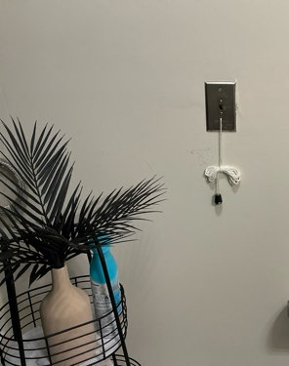
NSPIRE Standard - Example
Is this a NSPIRE Deficiency?
Yes

Slide 53
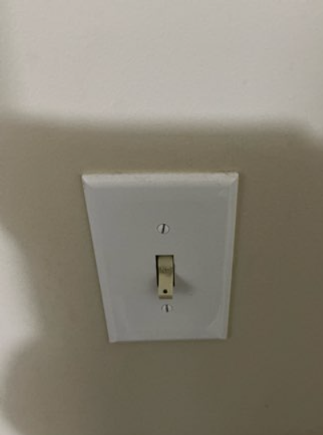
NSPIRE Standard - Example
Is this a NSPIRE Deficiency?
Yes

Slide 54
Recent Issues in Question
Wall-Mounted Light Fixtures/Bulb Modifications
Egress

Slide 55
NSPIRE Standard-Example
Exposed Electrical Conductor (Unit, Inside, or Outside)
DEFICIENCY CRITERIA:
Electrical conductor is not enclosed or properly insulated (e.g., damaged or missing sheathing that exposes the insulated wiring or conductor, open port, missing knockout, missing outlet or switch cover, or missing breaker or fuse).
OR
An opening or gap is present and measures greater than ½ inch.
Example conductors to be evaluated under this deficiency include but are not limited to:
Knockouts
Device cover plates that are missing (i.e., evidence of prior installation, but now are not present or are incomplete)
Device cover plates that are damaged (i.e., visibly defective; impacts functionality)
Lighting fixtures
Visible wire nuts on electrical conductors
Wiring that is insulated but not protected by sheathing or conduit
Hardwire smoke alarm with an exposed conductor
Wall-mounted light fixture with a damaged or missing cover

Slide 56
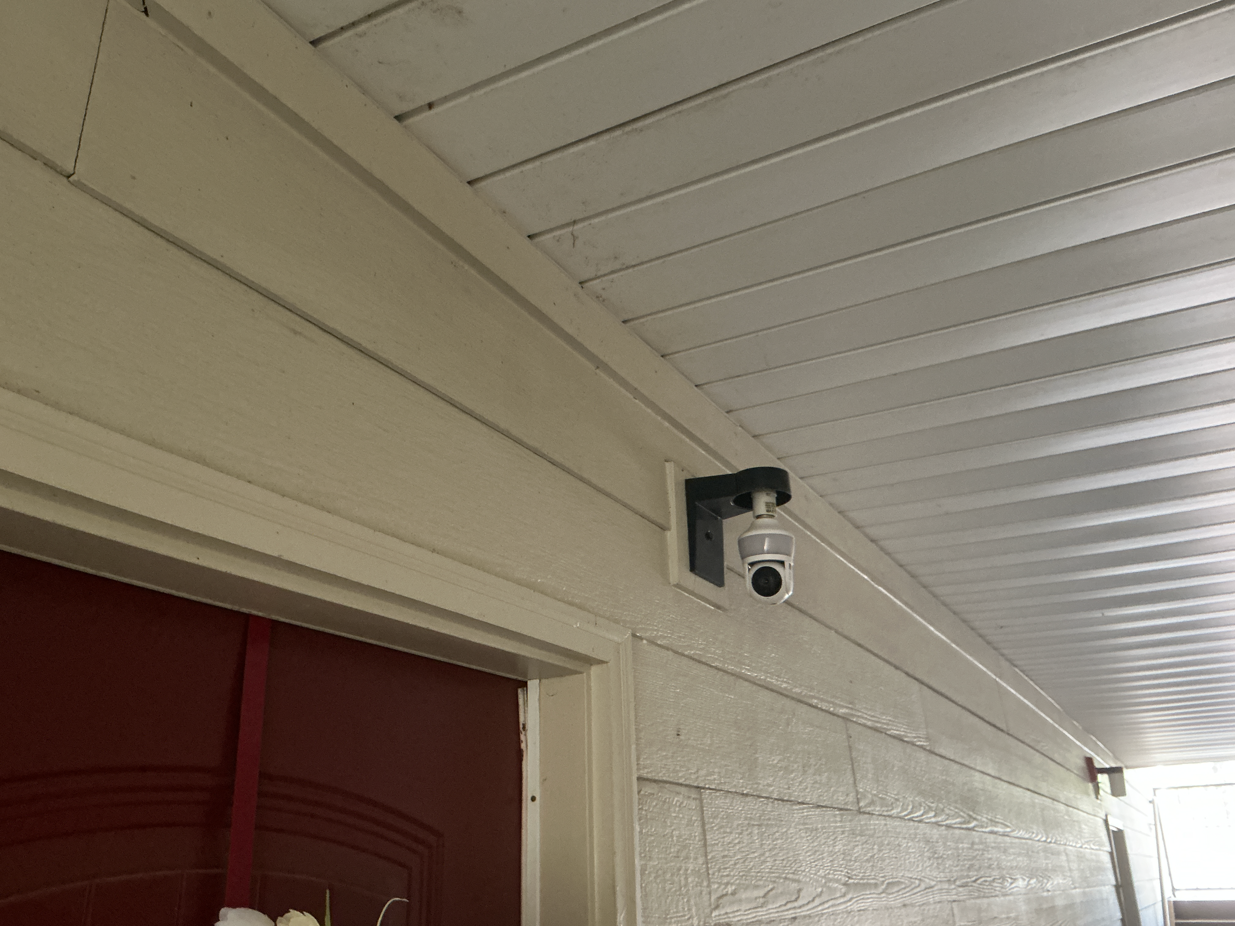
NSPIRE Standard-Example
Is this an exposed electrical conductor?
Yes
Wall-mounted light fixture with a damaged or missing cover

Slide 57
Egress
TITLE: EGRESS
VERSION: V3.0
DATE PUBLISHED: 08/11/23
DEFINITION:
A safe, continuous, and unobstructed path of travel from any point in the building, unit, or structure to the public way.
PURPOSE:
Provide a means of escape and rescue access in the event of an emergency.
COMMON COMPONENTS:
Door; Window; Escape ladder; Fire escape; Stairwell

Slide 58
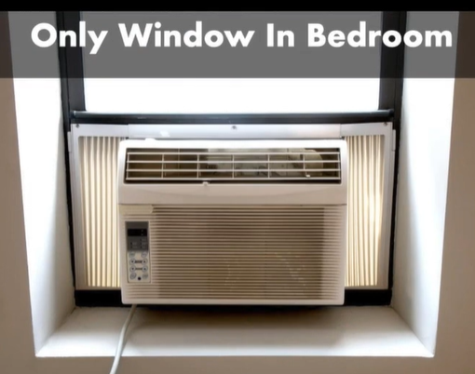
NSPIRE Standard - Example
Is this an egress issue?
The bedroom has 1-window.
Yes

Slide 59
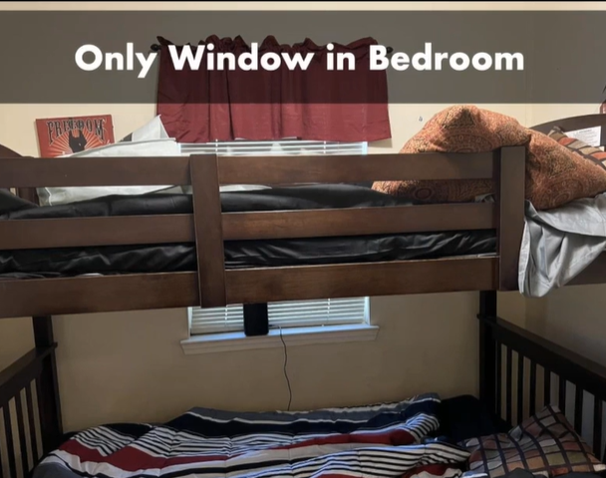
NSPIRE Standard - Example
Is this an egress issue?
The bedroom has 1-window.
No
Resident Owned Property

Slide 60
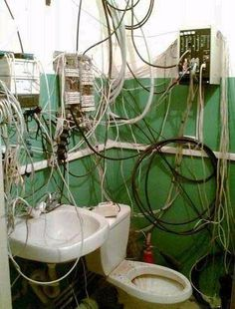
Severe and Life-Threatening (24-Hour Correction Period
Smoke Detectors
Call-for-aid
GFI/GFCI
Exposed electrical wires
Guardrails/Staircase
Infestation
Mold/Mildew
Sharp edges
Window

Slide 61
Alloweable Repairs
Missing light bulbs
Put stove back together
Light stove pilot light
Remove child safety devices
Plug in exhaust fans
Make access

Slide 62
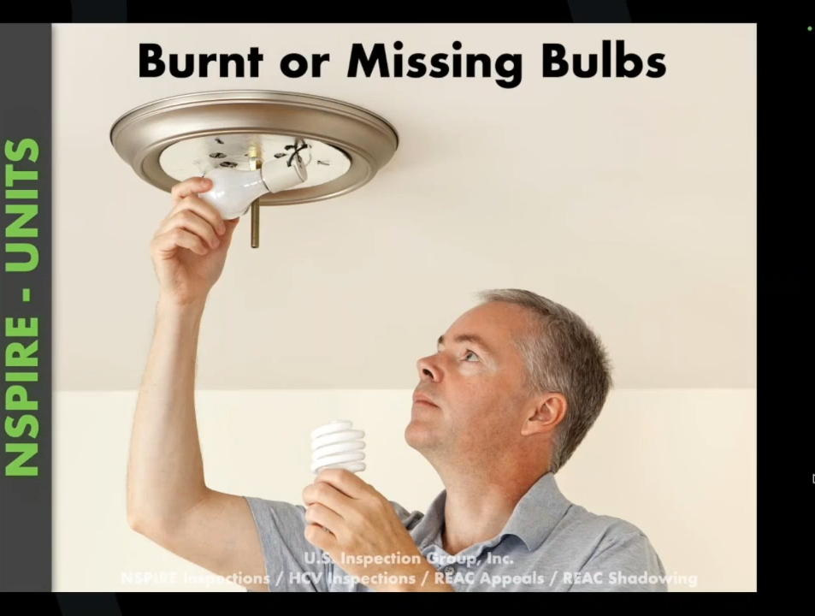

Slide 63
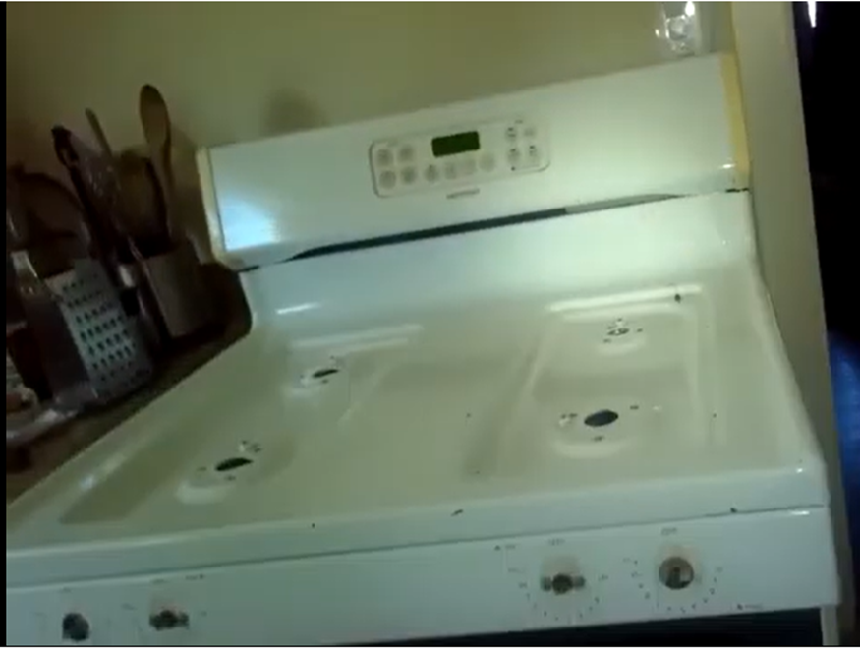
NSPIRE
Missing Stove Components

Slide 64
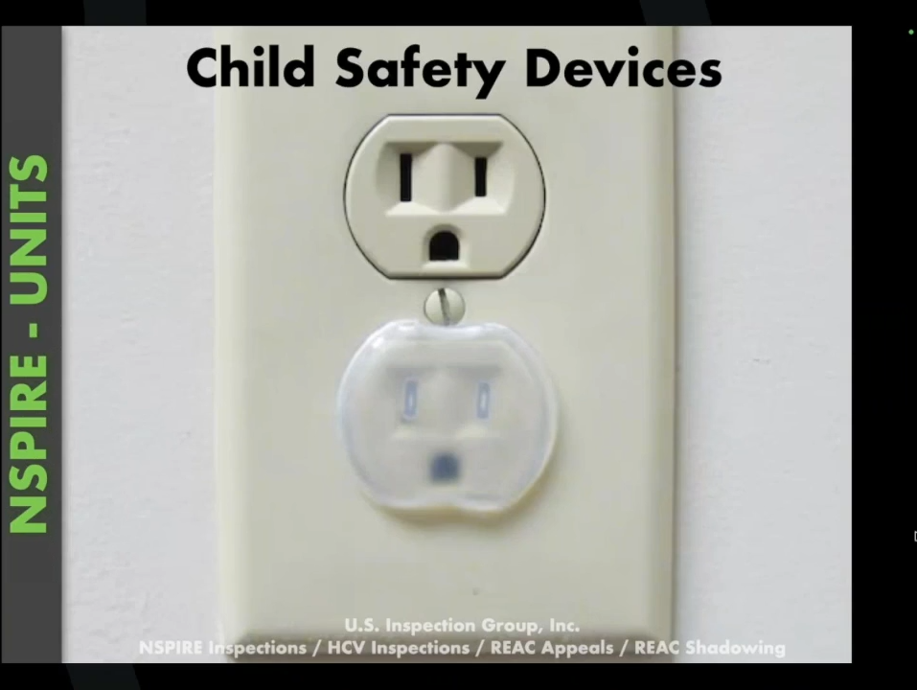

Slide 65


Slide 66

Cluttered Area

Slide 67



Can remove for purpose of completing the inspection, but not to eliminate the deficiency

Slide 68
Key Sites To Visit
https://www.hud.gov/reac/nspire-notices for HUD updates to NSPIRE
https://www.us-hc.com/
US Housing Consultants – Offers LIHTC and NSPIRE trainings.
https://usinspectiongroup.com
US Inspection Group - you can purchase NSPIRE field guides for quick reference, and you can email them with questions regarding defects at (isthisadefect.com). They’re good at responding within 24 hours most times. From this page you can access NSPIRE in 2 Minutes.
mfcompliance@ahfa.com
AHFA’s Compliance Department Email Address

